Slide 1
Quantification and visualization of periglacial surface deformation in the Inneres Hochebenkar cirque, Ötztal Alps, Austria
Viktor Kaufmann Institute of Geodesy Graz University of Technology Steyrergasse 30 A-8010 Graz, Austria E-mail: viktor.kaufmann@tugraz.at http://www.geoimaging.tugraz.at/viktor.kaufmann/
V. Kaufmann, 10.8.2008
Panorama: Obergurgl, Rotmoos valley, Äußeres Hochebenkar cirque, Gurgler Ferner

Slide 2
Quantification and visualization of periglacial surface deformation in the Inneres Hochebenkar cirque, Ötztal Alps, Austria
Contents 1. Introduction 2. Study area 3. Previous work 4. Data acquisition 5. Methods 6. Results 7. Discussion

Slide 3
Quantification and visualization of periglacial surface deformation in the Inneres Hochebenkar cirque, Ötztal Alps, Austria 1. Introduction
Climate change has significant influence on the Earth’s cryosphere.
Atmospheric warming during the last 150 years has caused strong glacier recession and also permafrost degradation.
Mountain/alpine permafrost
Ötztal Alps, Austria
Äußeres Hochebenkar cirque (rock glacier)
Austria’s prime rock glacier
It is well-known for its long record of continuous photogrammetric and geodetic measurements.
Inneres Hochebenkar cirque (rock glacier & glacier)
Haeberli and Patzelt (1982), Krainer et al. (2015)
The main focus of the present paper is to document the past and the more recent surface change of the periglacial (= non-glaciated) environment of the Inneres Hochebenkar cirque.

Slide 4
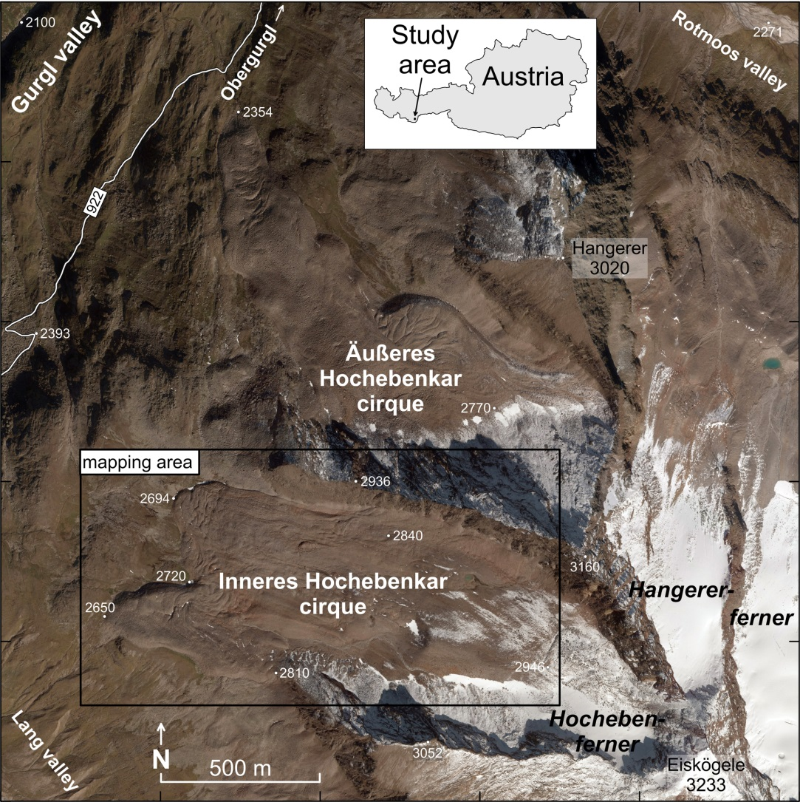
Quantification and visualization of periglacial surface deformation in the Inneres Hochebenkar cirque, Ötztal Alps, Austria 2. Study area
Inneres Hochebenkar cirque
Orthophoto, 11.9.2010 © Land Tirol

Slide 5
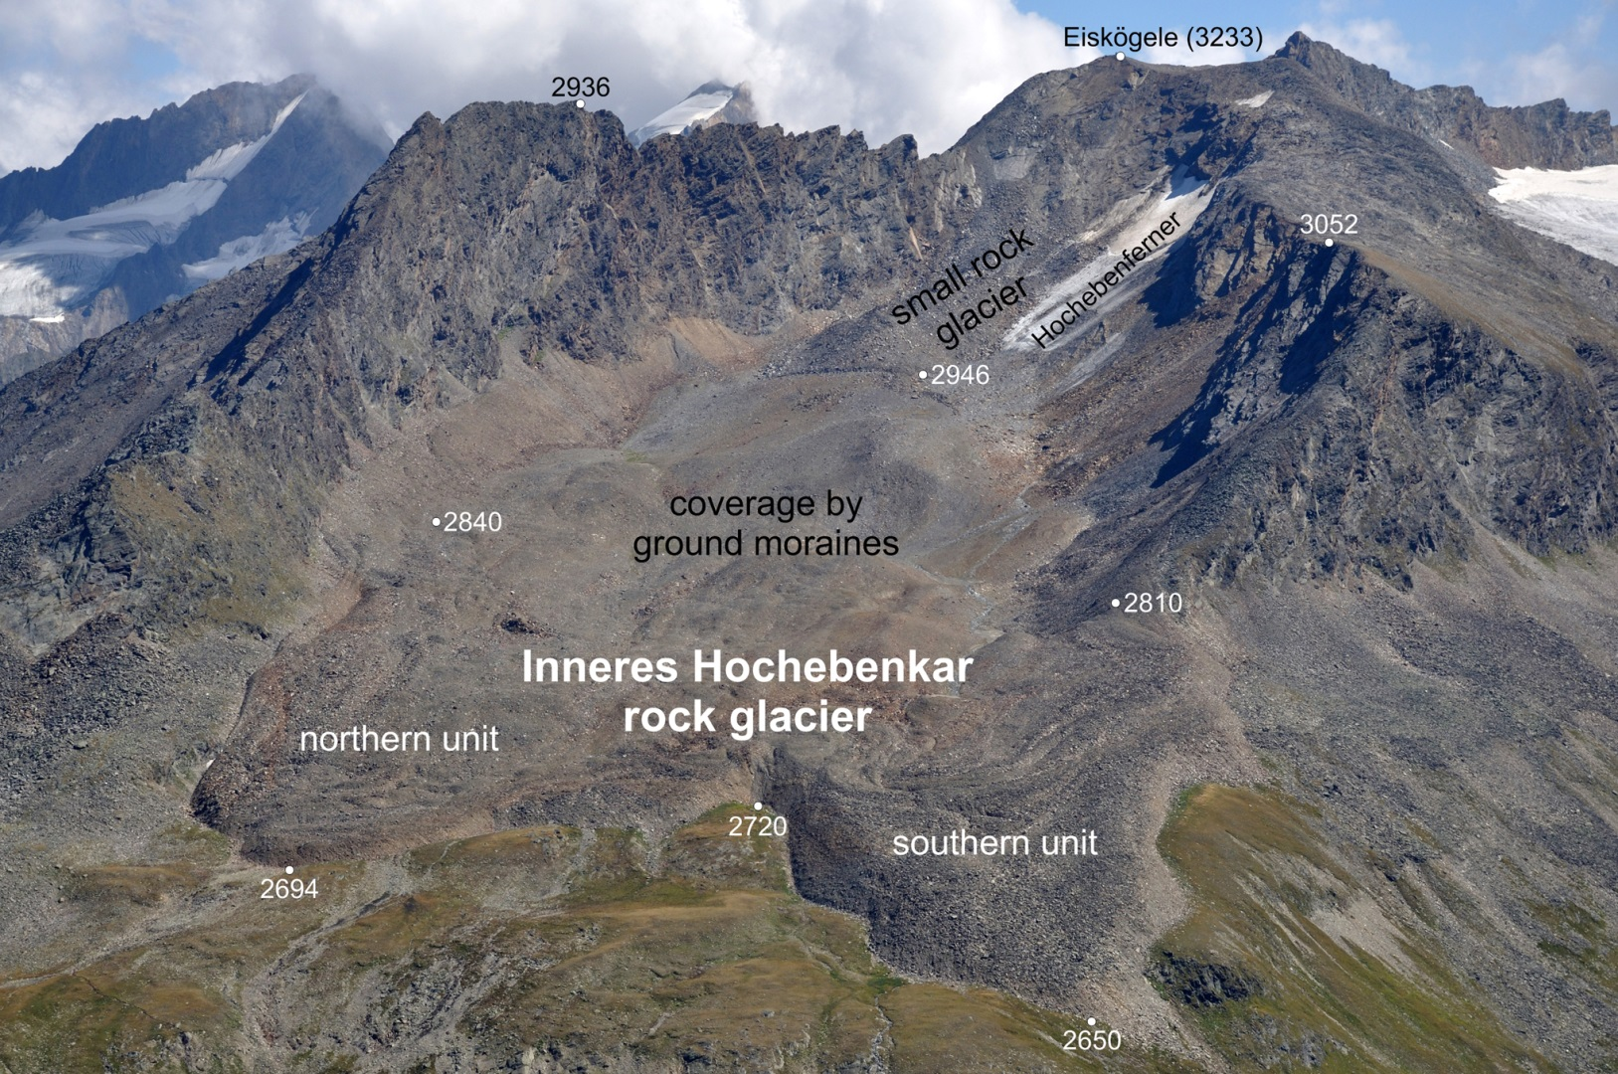
Quantification and visualization of periglacial surface deformation in the Inneres Hochebenkar cirque, Ötztal Alps, Austria 2. Study area
Inneres Hochebenkar cirque
Inneres Hochebenkar rock glacier
Photo taken on 31.8.2015 by A. Kleb.

Slide 6
Quantification and visualization of periglacial surface deformation in the Inneres Hochebenkar cirque, Ötztal Alps, Austria 2. Study area
Virtual overflight
Source: Kaufmann & Plösch (1999, 2001) http://www.geoimaging.tugraz.at/viktor.kaufmann/animations.html
Aerial photograph © BEV, Vienna
Inneres Hochebenkar cirque/rock glacier

Slide 7
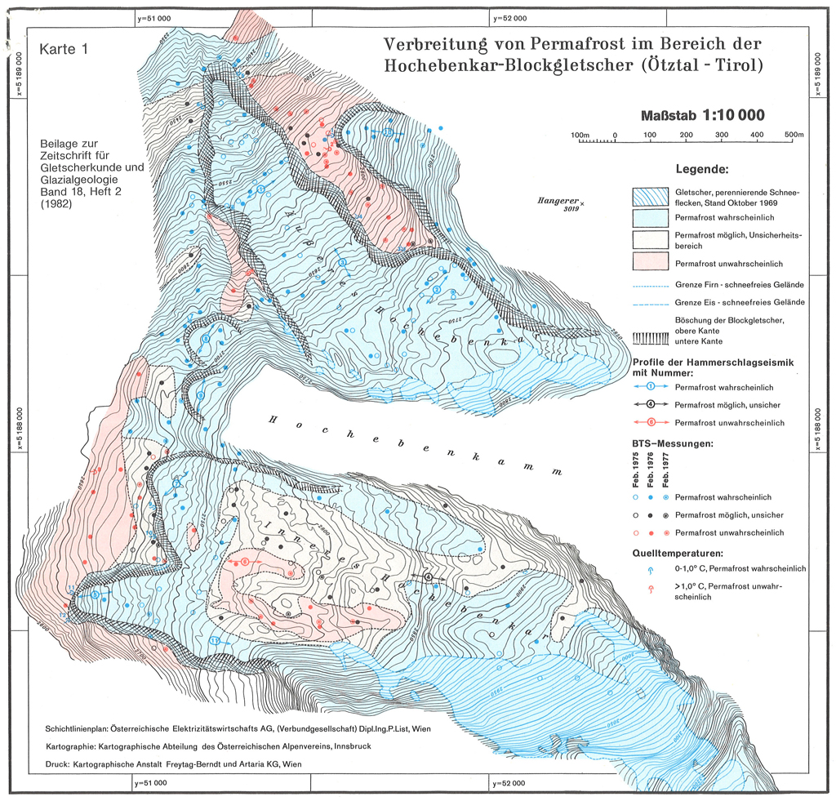
Quantification and visualization of periglacial surface deformation in the Inneres Hochebenkar cirque, Ötztal Alps, Austria 3. Previous work
Permafrost studies
Haeberli and Patzelt (1982)
Source: Haeberli & Patzelt (1982)

Slide 8
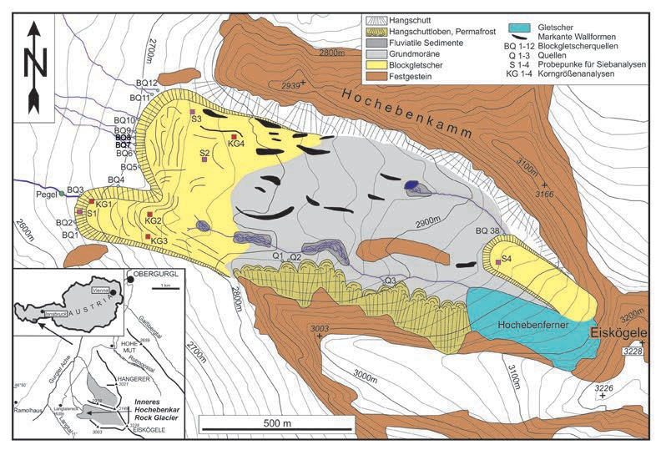
Quantification and visualization of periglacial surface deformation in the Inneres Hochebenkar cirque, Ötztal Alps, Austria 3. Previous work
Permafrost studies
Krainer et al. (2015)
Geomorphology
Hydrology
Geological/Geomorphological map
Source: Krainer et al. (2015)

Slide 9
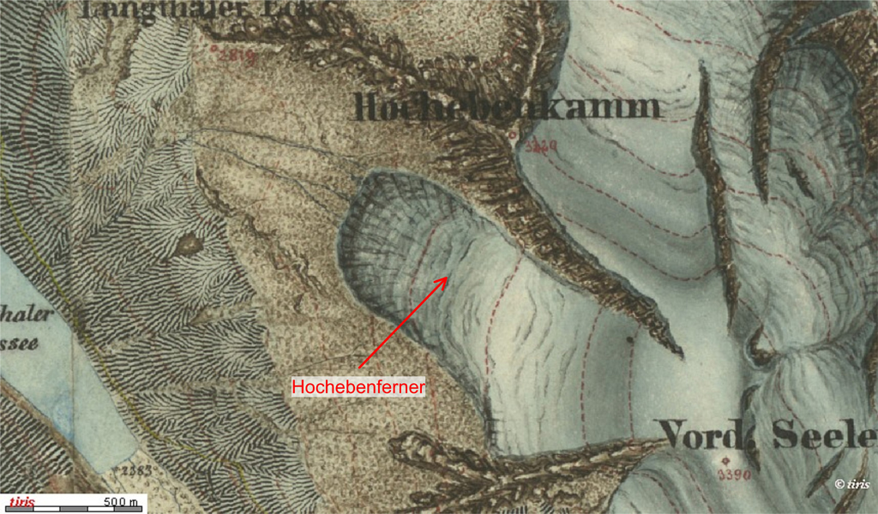
Quantification and visualization of periglacial surface deformation in the Inneres Hochebenkar cirque, Ötztal Alps, Austria 3. Previous work
Supporting maps
'Dritte Landesaufnahme' 1864-1887 (survey 1870-1873)

Slide 10
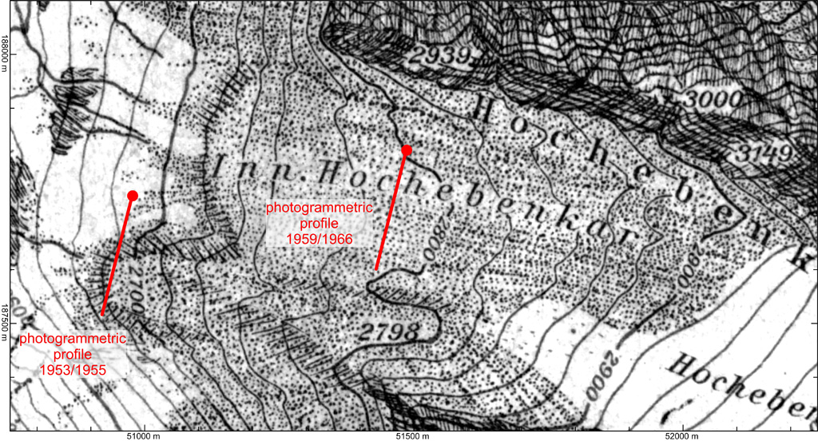
Quantification and visualization of periglacial surface deformation in the Inneres Hochebenkar cirque, Ötztal Alps, Austria 3. Previous work
Supporting maps
Map 'Ötztaler Alpen, Blatt Gurgl' 1:25,000 (photogrammetric survey 1936), published in 1949 by the Austrian Alpine Club.

Slide 11
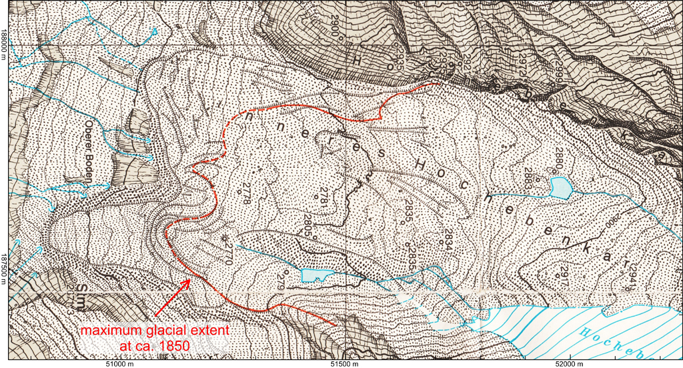
Quantification and visualization of periglacial surface deformation in the Inneres Hochebenkar cirque, Ötztal Alps, Austria 3. Previous work
Supporting maps
Map ‘Gurgler Ferner 1981’ 1:10,000 (published in 1986)
Source: Patzelt (1986)

Slide 12
Quantification and visualization of periglacial surface deformation in the Inneres Hochebenkar cirque, Ötztal Alps, Austria 3. Previous work
Measurement of flow velocity
Terrestrial photogrammetry (Pillewizer, 1957; Vietories, 1972)
Surveys 1953/1955 by W. Pillewizer - frontal slope of the southern unit - mean annual flow velocity of 1.10 m a⁻¹
Surveys 1959/1966 by E. Dorrer - stable rock outcrop at 2800 m - no movements were detected
Satellite radar interferometry (Rott & Siegl, 1999)
ERS-1/2 SAR images (two interferometric pairs in July/August 1995)
two separate moving units were detected; calculated displacements rates were several centimeters within the 35 days repeat cycle
Aerial photogrammetry (Kaufmann & Ladstädter, 2002)
stringent photogrammetric approach
time period 1953-1997 (max. flow velocity of 55/49 cm a⁻¹)

Slide 13
Quantification and visualization of periglacial surface deformation in the Inneres Hochebenkar cirque, Ötztal Alps, Austria 4. Data acquisition
Aerial surveys 1953-2010
Date | Flying height above ground (m) | Camera type | Scale/ GSD* | Remark
31.8.1953 | 3250 | analog | 1 : 15,450 | B&W
7.10.1969 | 4430 | analog | 1 : 29,150 | B&W
7.9.1981 | 2930 | analog | 1 : 19,150 | B&W
10.10.1990 | 5240 | analog | 1 : 34,300 | B&W, snow cover
11.9.1997 | 5580 | analog | 1 : 36,550 | B&W
5.9.2003 | 5360 | analog | 1 : 17,650 | color-positive
11.9.2010 | 2810 | digital | 17* cm | R,G,B, NIR
* GSD … ground sampling distance

Slide 14
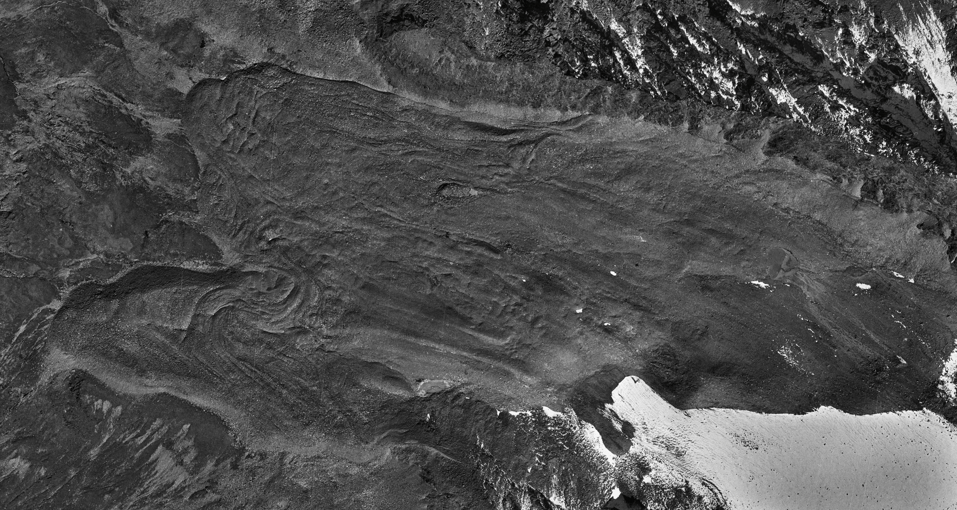
Quantification and visualization of periglacial surface deformation in the Inneres Hochebenkar cirque, Ötztal Alps, Austria 4. Data acquisition
Aerial surveys 1953/2003
Computer animation: Orthophotos 1953/2003
Data 1953: © BEV, Vienna
Data 2003: © Land Tirol

Slide 15
Quantification and visualization of periglacial surface deformation in the Inneres Hochebenkar cirque, Ötztal Alps, Austria 4. Data acquisition
Digital elevation/surface models 1953-2010
Date | Grid spacing | Origin | Remark
31.8.1953 | 2.5 m x 2.5 m | photogrammetric mapping | DEM
11.9.1997 | 2.5 m x 2.5 m | photogrammetric mapping | DEM
23.8.2006 | 1 m x 1 m | ALS | DEM and DSM
9.10.2010 | 1 m x 1 m | ALS | DEM and DSM

Slide 16
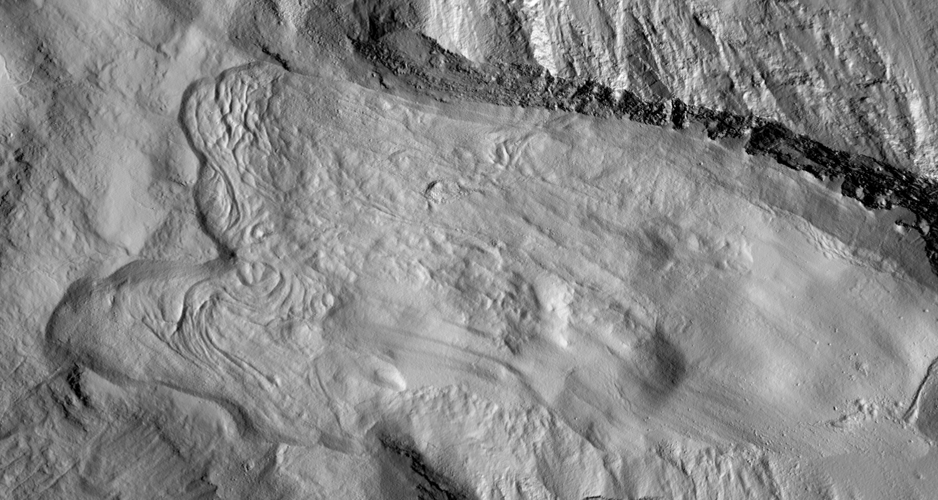
Quantification and visualization of periglacial surface deformation in the Inneres Hochebenkar cirque, Ötztal Alps, Austria 4. Data acquisition
Computer animation: DSM 2006/2010
DSMs © Land Tirol

Slide 17
Quantification and visualization of periglacial surface deformation in the Inneres Hochebenkar cirque, Ötztal Alps, Austria 5. Methods
Measurement of flow velocity
Image-based change detection
ImageStation of Intergraph (Orthophotos, DEMs)
Image matching (normalized cross-correlation coefficient)
Matlab-based toolbox
DEM/DSM-based change detection
Height field matching (normalized cross-correlation coefficient)

Slide 18
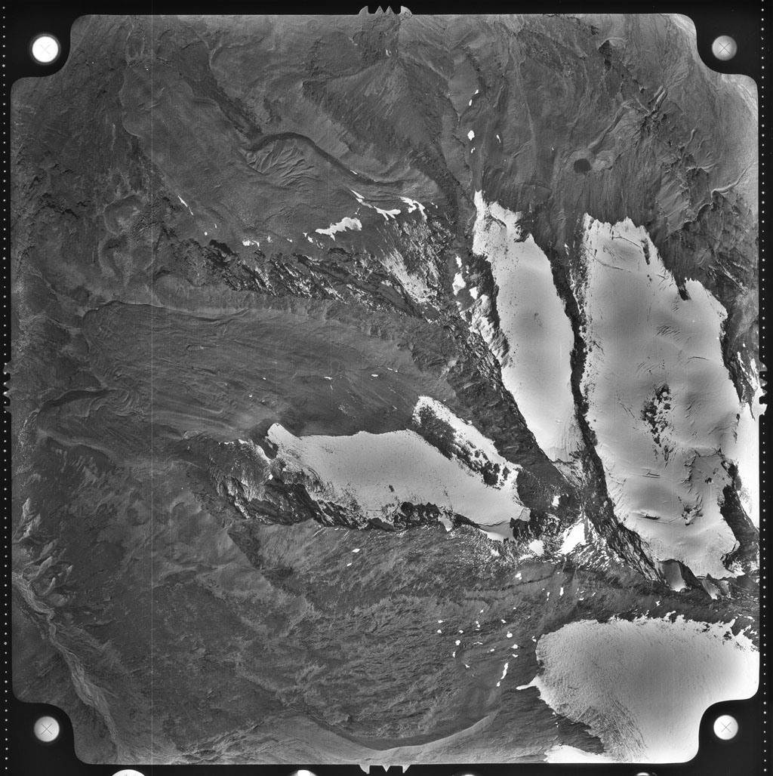
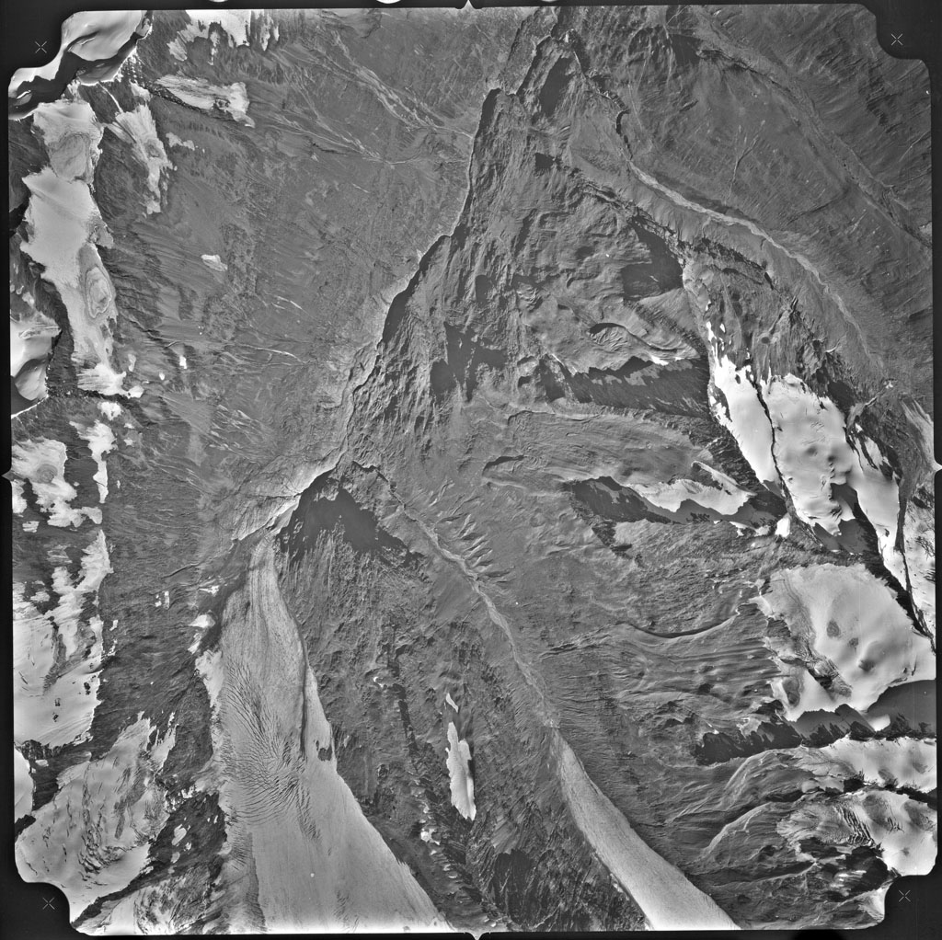
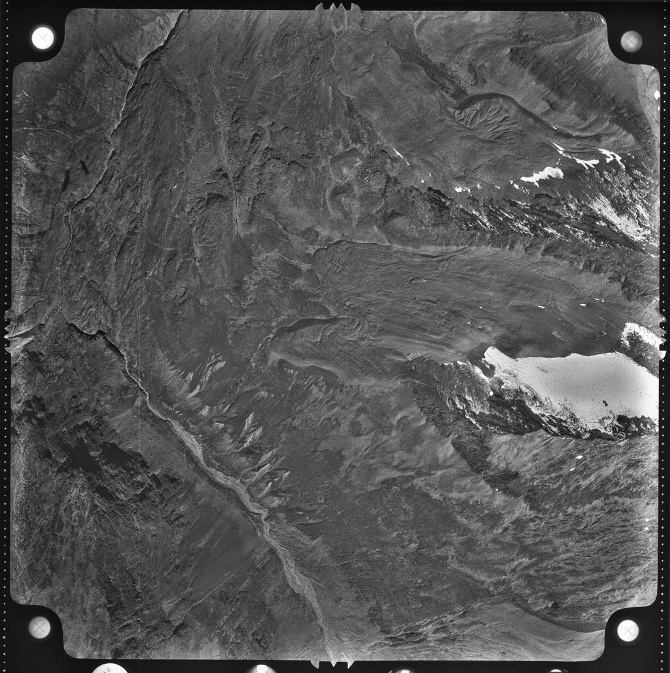
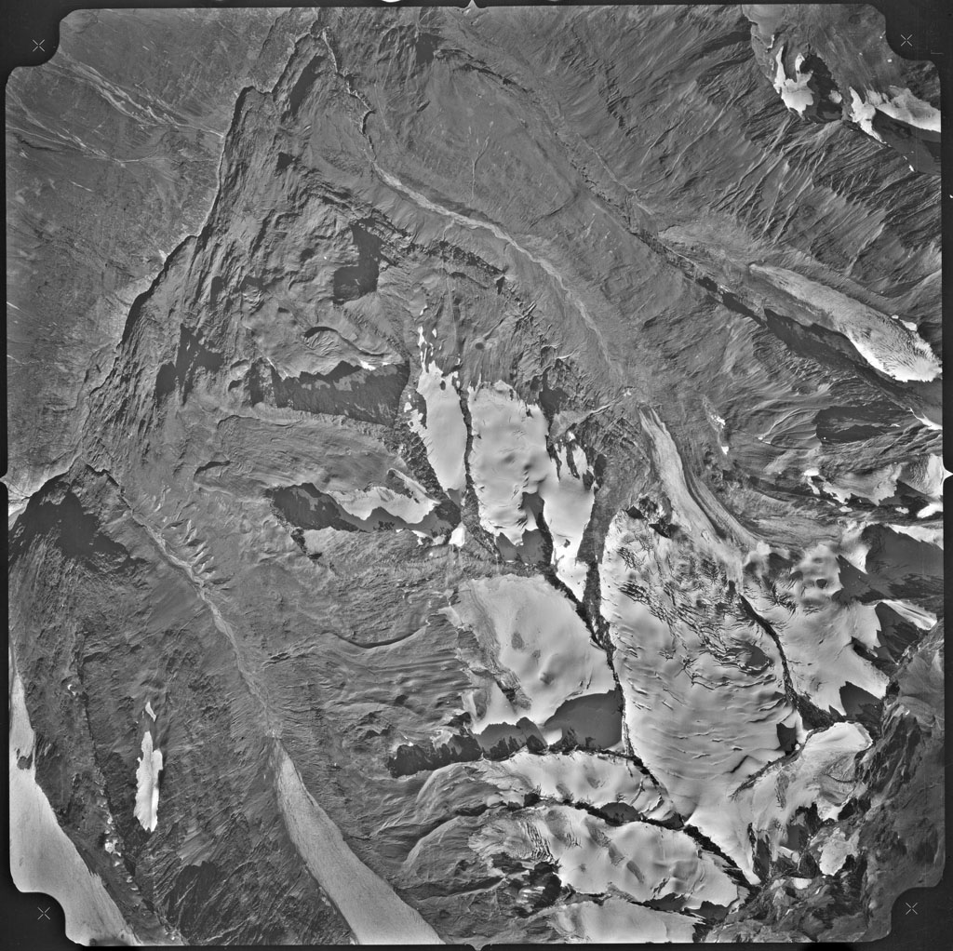
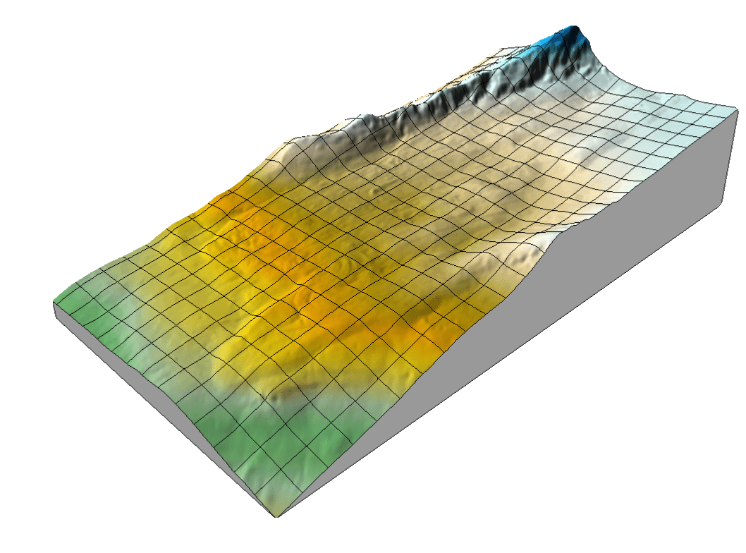
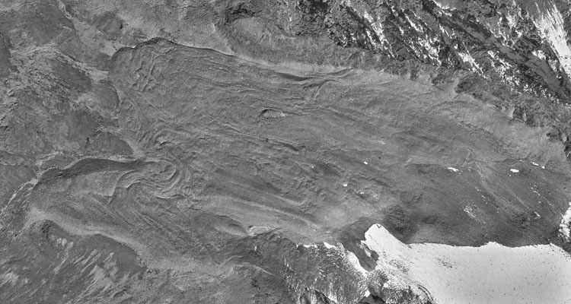
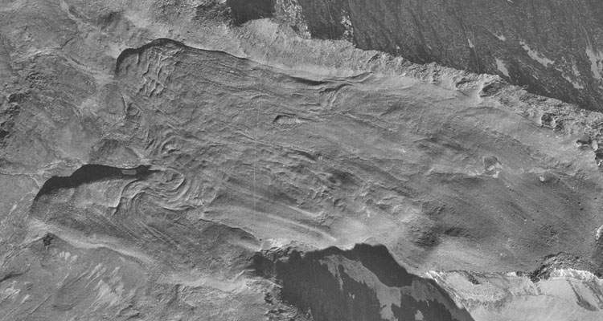
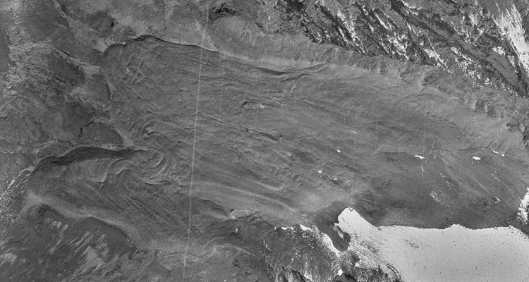
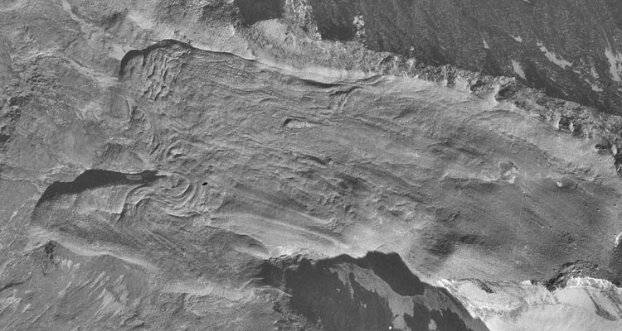
Quantification and visualization of periglacial surface deformation in the Inneres Hochebenkar cirque, Ötztal Alps, Austria 5. Methods
Image data © BEV, Vienna
Inneres Hochebenkar cirque
mapping area
1953
1969
DEM 1953
Orthophoto, 1953
Orthophoto, 1969

Slide 19
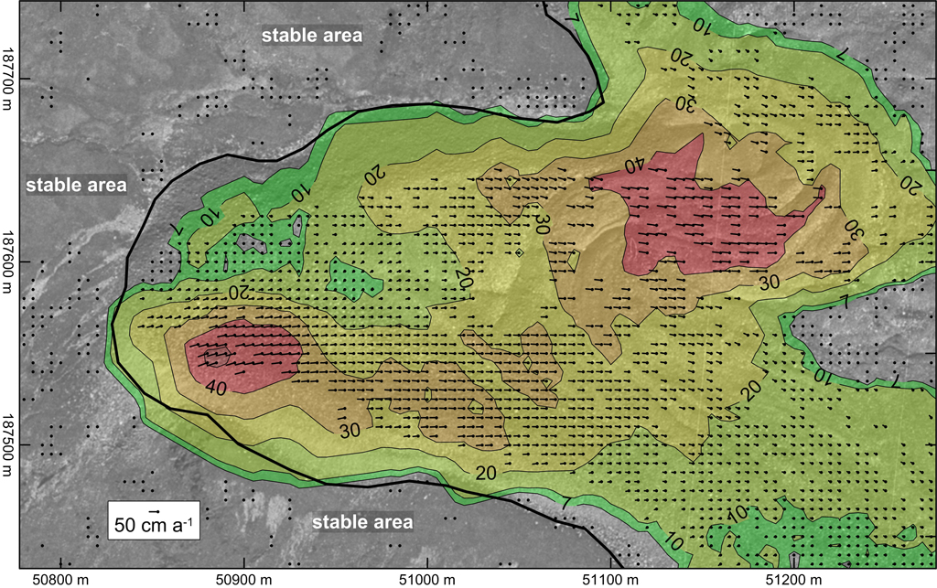
Quantification and visualization of periglacial surface deformation in the Inneres Hochebenkar cirque, Ötztal Alps, Austria 5. Methods
Mean annual horizontal flow velocity of the southern unit of Inneres Hochebenkar rock glacier for the time period 1953-1969.
© BEV, Vienna

Slide 20
Quantification and visualization of periglacial surface deformation in the Inneres Hochebenkar cirque, Ötztal Alps, Austria 5. Results
Horizontal flow velocity
Time interval | No. of valid measurements | Significance level⁺ of flow velocity (cm a⁻¹) | Max. flow velocity (cm a⁻¹) – northern unit | Max. flow velocity (cm a⁻¹) – southern unit
1953-2010 | 12009 | ±2.5 | 36.4 | 36.7
1953-1969 | 10625 | ±7.0 | 56.5 | 52.7
1969-1981 | 10390 | ±10.0 | 34.0 | 37.8
1981-1997 | 19456 | ±6.5 | 31.8 | 39.8
1981-1990 | 9921 | ±8.5 | 26.2 | 39.5
1990♦-1997 | too few points | --- | --- | ---
1997-2010 | 24293 | ±7.0 | 33.1 | 40.1
2003-2010 | 29279 | ±10.0 | 32.9 | 46.7
2006-2010* | 10556 | ±8.5 | 24.6 | 57.2
⁺ … 3σ ♦ … snow cover
* … evaluation of DSMs

Slide 21
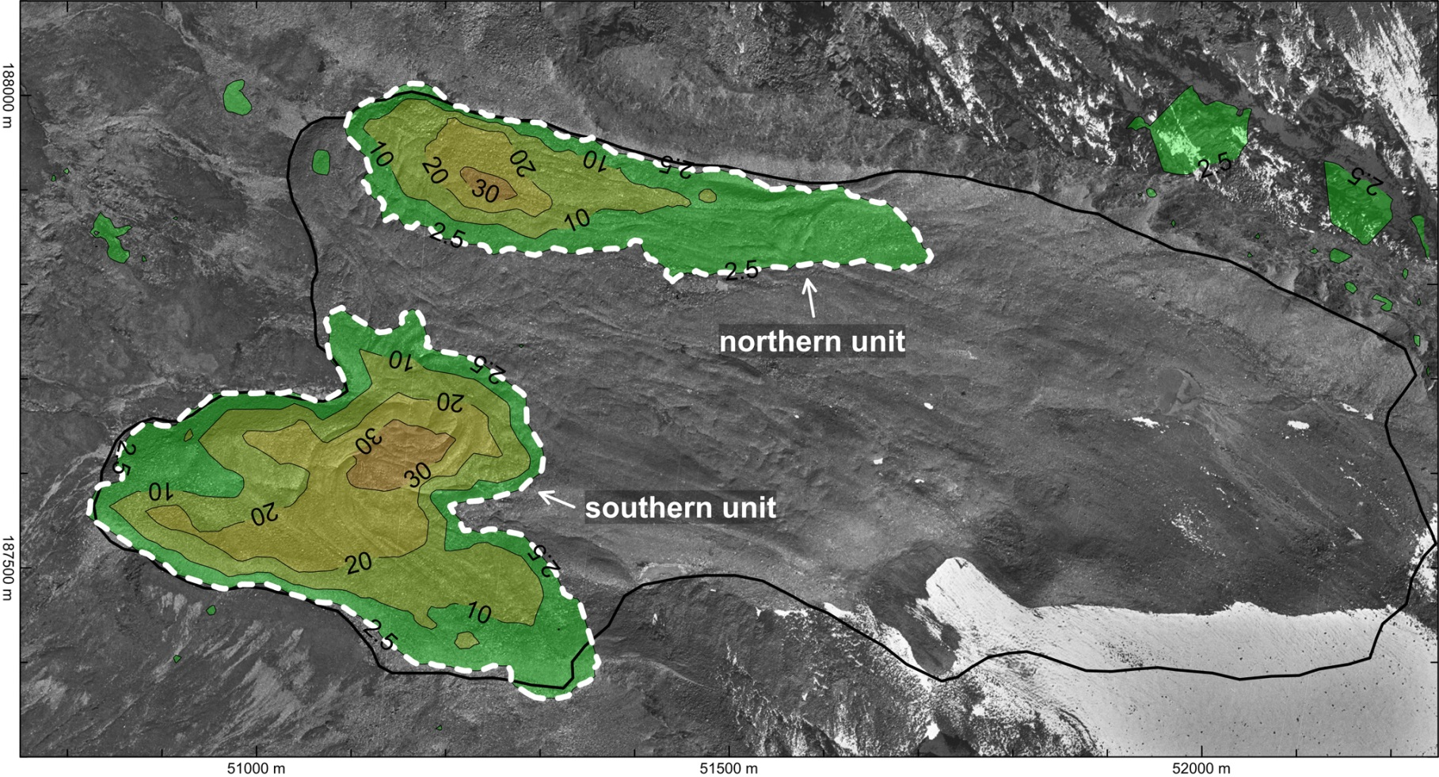
Quantification and visualization of periglacial surface deformation in the Inneres Hochebenkar cirque, Ötztal Alps, Austria 5. Results
Horizontal flow velocity
Mean annual horizontal flow velocity for the time period 1953-2010, isotachs (cm a⁻¹), significance level at 2.5 cm a⁻¹ (3σ).
© BEV, Vienna

Slide 22
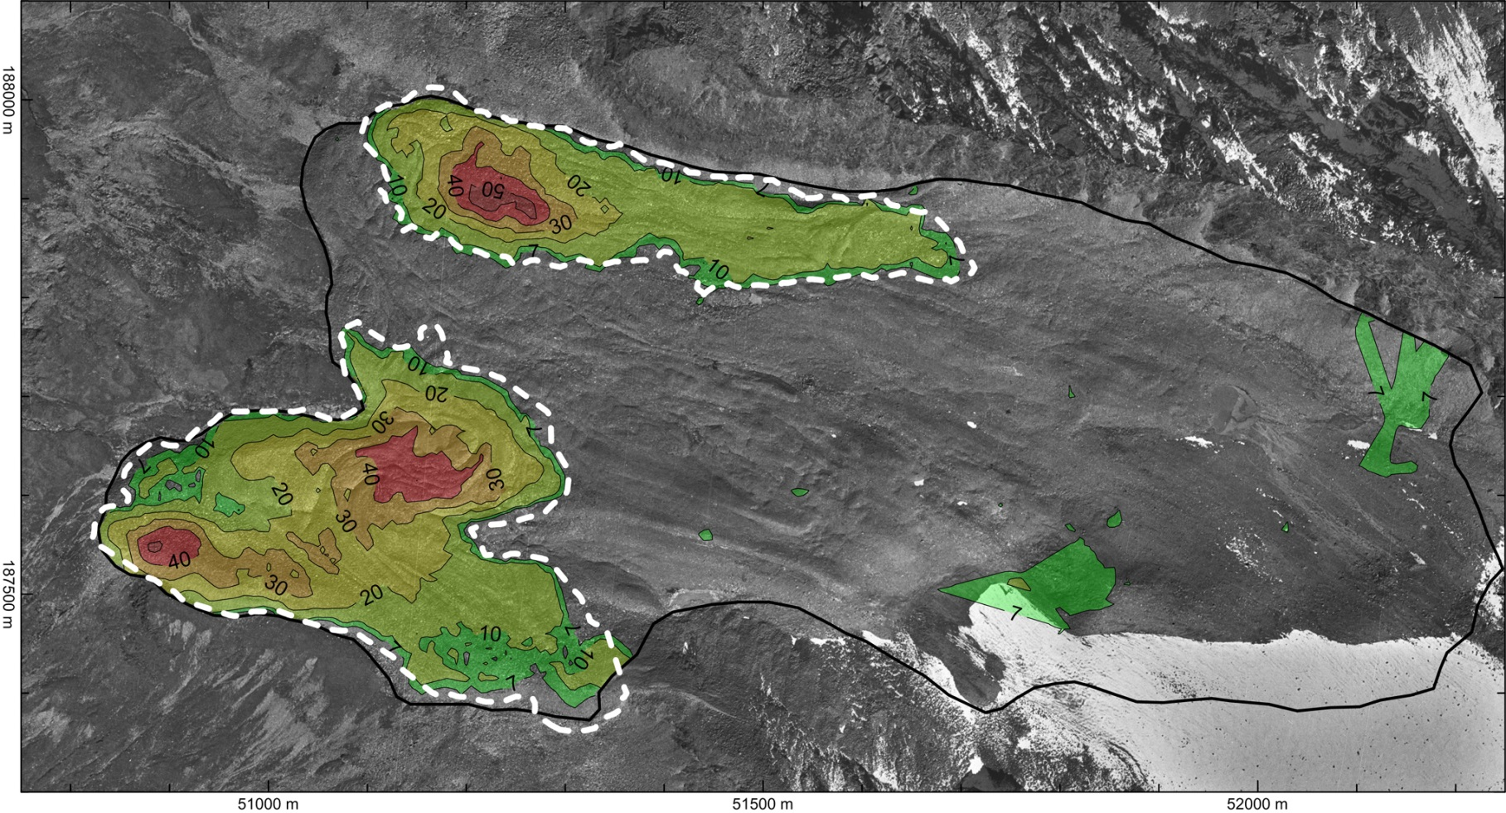
Quantification and visualization of periglacial surface deformation in the Inneres Hochebenkar cirque, Ötztal Alps, Austria 5. Results
Horizontal flow velocity
Mean annual horizontal flow velocity for the time period 1953-1969, isotachs (cm a⁻¹), significance level at 7 cm a⁻¹ (3σ).
© BEV, Vienna

Slide 23
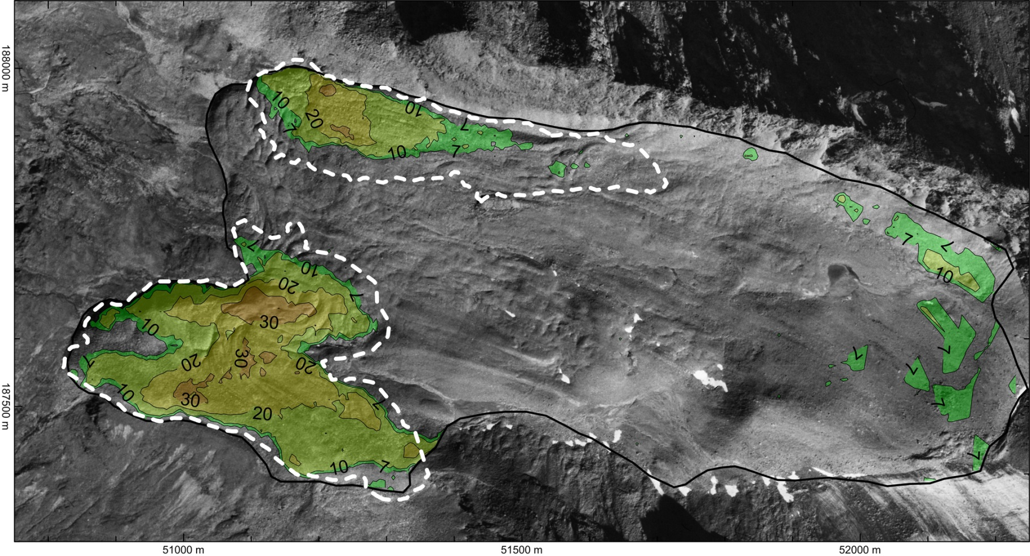
Quantification and visualization of periglacial surface deformation in the Inneres Hochebenkar cirque, Ötztal Alps, Austria 5. Results
Horizontal flow velocity
Mean annual horizontal flow velocity for the time period 1997-2010, isotachs (cm a⁻¹), significance level at 7 cm a⁻¹ (3σ).
© BEV, Vienna

Slide 24
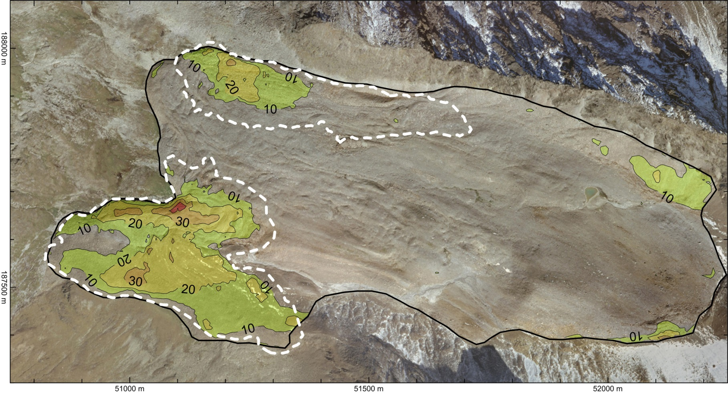
Quantification and visualization of periglacial surface deformation in the Inneres Hochebenkar cirque, Ötztal Alps, Austria 5. Results
Horizontal flow velocity
Mean annual horizontal flow velocity for the time period 2003-2010, isotachs (cm a⁻¹), significance level at 10 cm a⁻¹ (3σ).
© Land Tirol

Slide 25
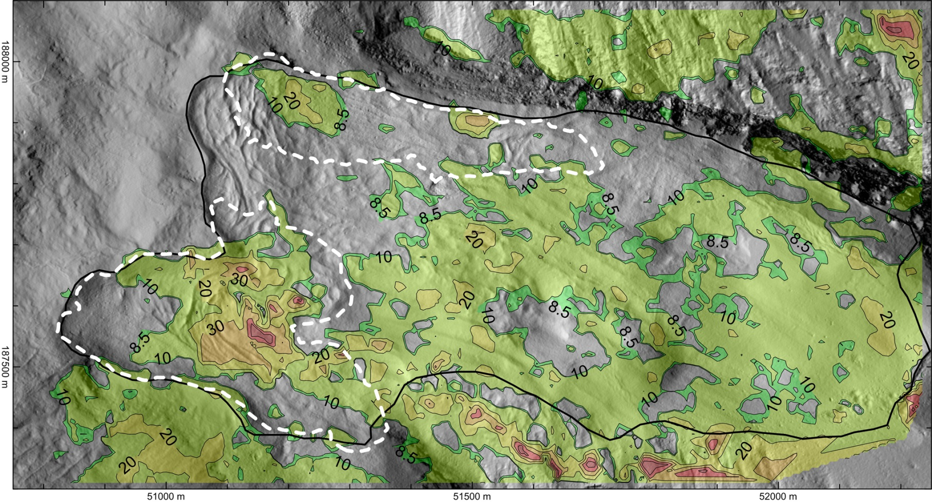
Quantification and visualization of periglacial surface deformation in the Inneres Hochebenkar cirque, Ötztal Alps, Austria 5. Results
Horizontal flow velocity (DSM-based change detection)
Mean annual horizontal flow velocity for the time period 2006-2010, isotachs (cm a⁻¹), significance level at 8.5 cm a⁻¹ (3σ).
© Land Tirol

Slide 26
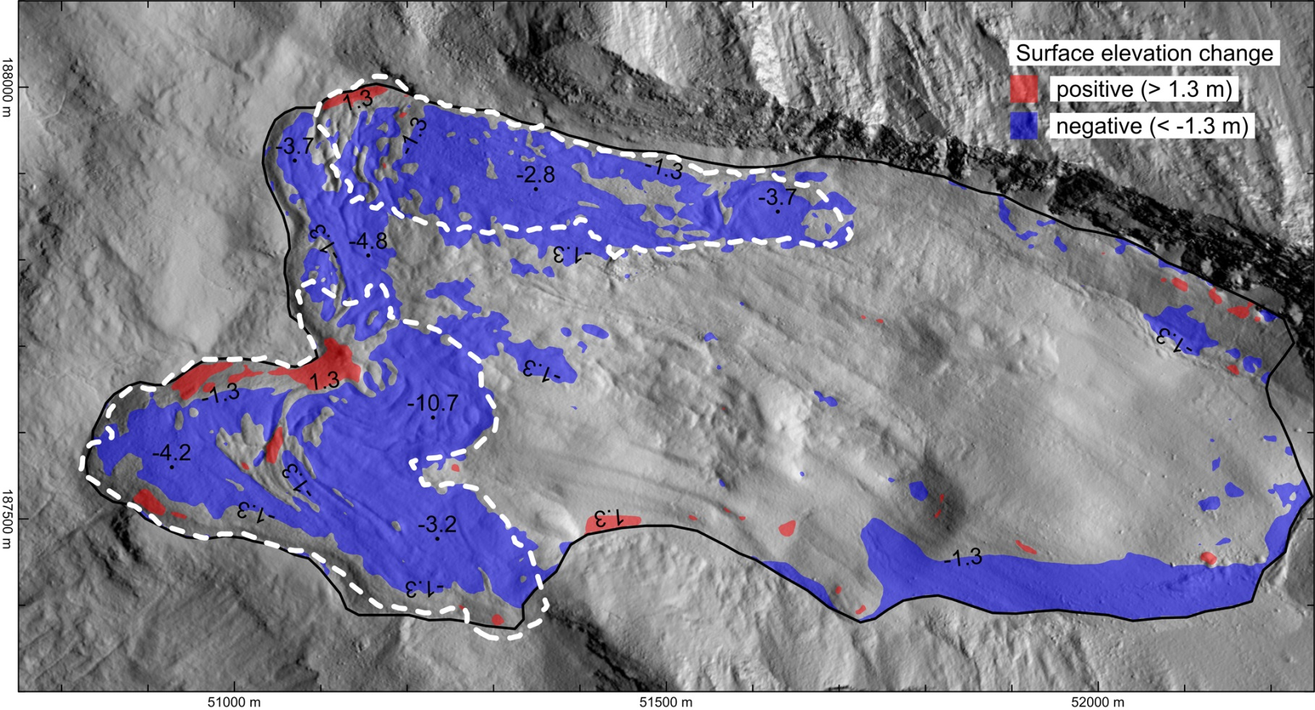
Quantification and visualization of periglacial surface deformation in the Inneres Hochebenkar cirque, Ötztal Alps, Austria 5. Results
Surface elevation change
Surface elevation change for the time period 1953-2006, significance level at ±1.3 m (3σ).

Slide 27
Quantification and visualization of periglacial surface deformation in the Inneres Hochebenkar cirque, Ötztal Alps, Austria 6. Discussion
The lower part of Inneres Hochebenkar cirque holds two independently moving parts, i.e., the northern and southern unit of Inneres Hochebenkar rock glacier.
Highest flow velocities (1.10 m a⁻¹) of Inneres Hochebenkar rock glacier were measured by Pillewizer at the southern unit in the time period 1953-1955. In the overlapping observation period 1953-1969 the flow velocity has already decreased significantly. Maximum flow velocities hardly surpassed 50 cm a⁻¹. In the course of time the northern unit has reduced its speed more than the southern unit. A recent speed-up of the movement of the southern unit is speculative.
Permafrost degradation/melt at Inneres Hochebenkar rock glacier is rather difficult to quantify.
However, we found some strong indication that the lower (non-moving) end part connecting both moving units has undergone substantial surface lowering (2.0-4.7 m in 1953-1997).
Dense image matching will allow the automatic generation of high-resolution DEMs. Thus, true orthophotos can be obtained more easily.
The potential of the available multi-temporal ALS data could not be fully exploited because of obvious geometric problems in fusing both data sets.

Slide 28
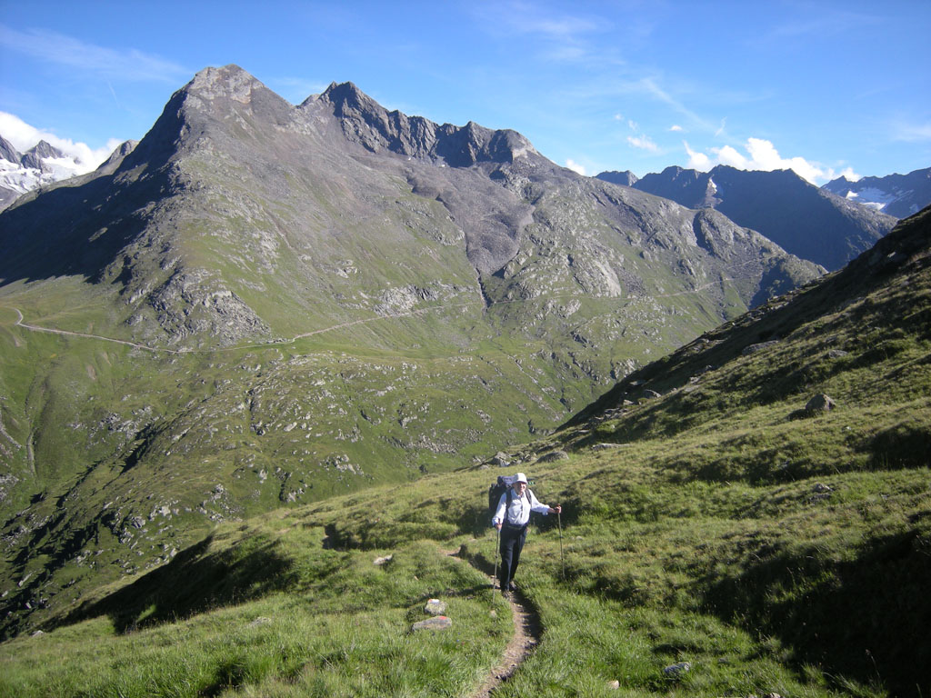
Quantification and visualization of periglacial surface deformation in the Inneres Hochebenkar cirque, Ötztal Alps, Austria
Thank you for your attention!
V. Kaufmann, 10.8.2008

