Slide 1
Institute of Geodesy
Panta rhei: Movement change of Tschadinhorn rock glacier (Hohe Tauern range, Austria) for the time period 1954-2017
Viktor Kaufmann W. Sulzer, G. Seier and M. Wecht Institute of Geodesy Institute of Geography and Regional Science Graz University of Technology University of Graz Steyrergasse 30 A-8010 Graz, Austria E-mail: viktor.kaufmann@tugraz.at https://www.staff.tugraz.at/viktor.kaufmann/
V. Kaufmann, 25.8.2016
Panorama: Tschadinhorn rock glacier, Grossglockner (3798 m) in the background

Slide 2
Panta rhei: Movement change of Tschadinhorn rock glacier (Hohe Tauern range, Austria) for the time period 1954-2017
Contents 1. Introduction 2. Study area 3. Previous work 4. Data 5. Methods 6. Results 7. Discussion
Raphael’s School of Athens, detail showing Raphael’s portrait of Michelangelo as Heraclitus 1500s, permission PDArt

Slide 3
Panta rhei: Movement change of Tschadinhorn rock glacier (Hohe Tauern range, Austria) for the time period 1954-2017 1. Introduction
Rock glaciers are creep phenomena of mountain permafrost.
Rock glaciers are responsible for extensive mass transport in alpine environments.
The movement of rock glaciers is generally not constant over time but changes within different time scale.
The main goal of this work is to reconstruct the surface movement (kinematics) of Tschadinhorn rock glacier for the time period 1954 to 2017 on a multi-annual to interannual time scale.
The results obtained are intended to provide a basis for the investigation of climate change and more in-depth morphological studies.
Different measurement techniques of surface movement exist.
Repeat aerial surveys
Archive data from the Austrian Federal Office of Metrology and Surveying (BEV)
UAV-based data

Slide 4
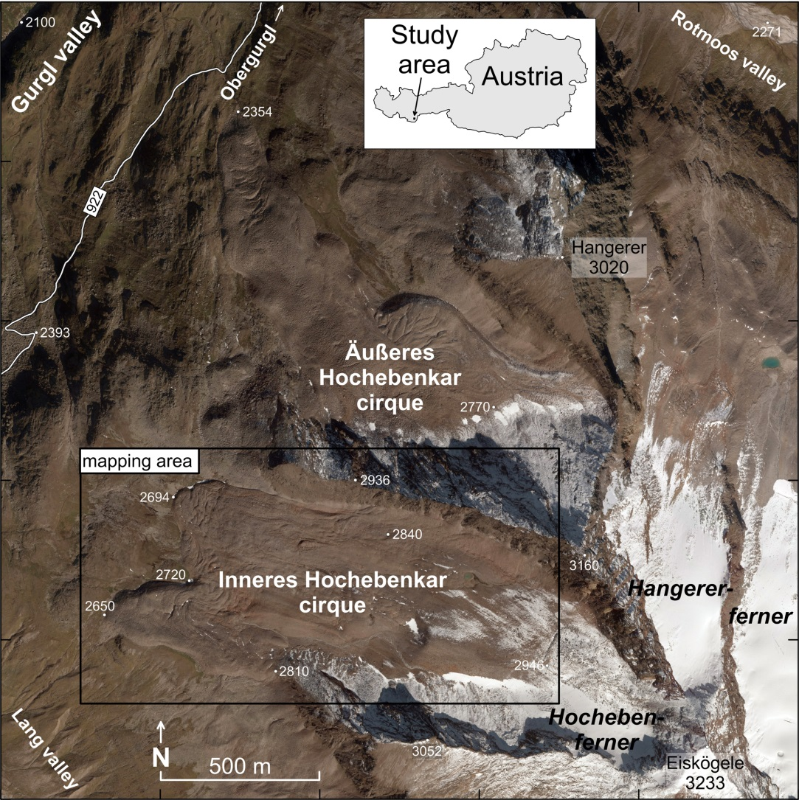
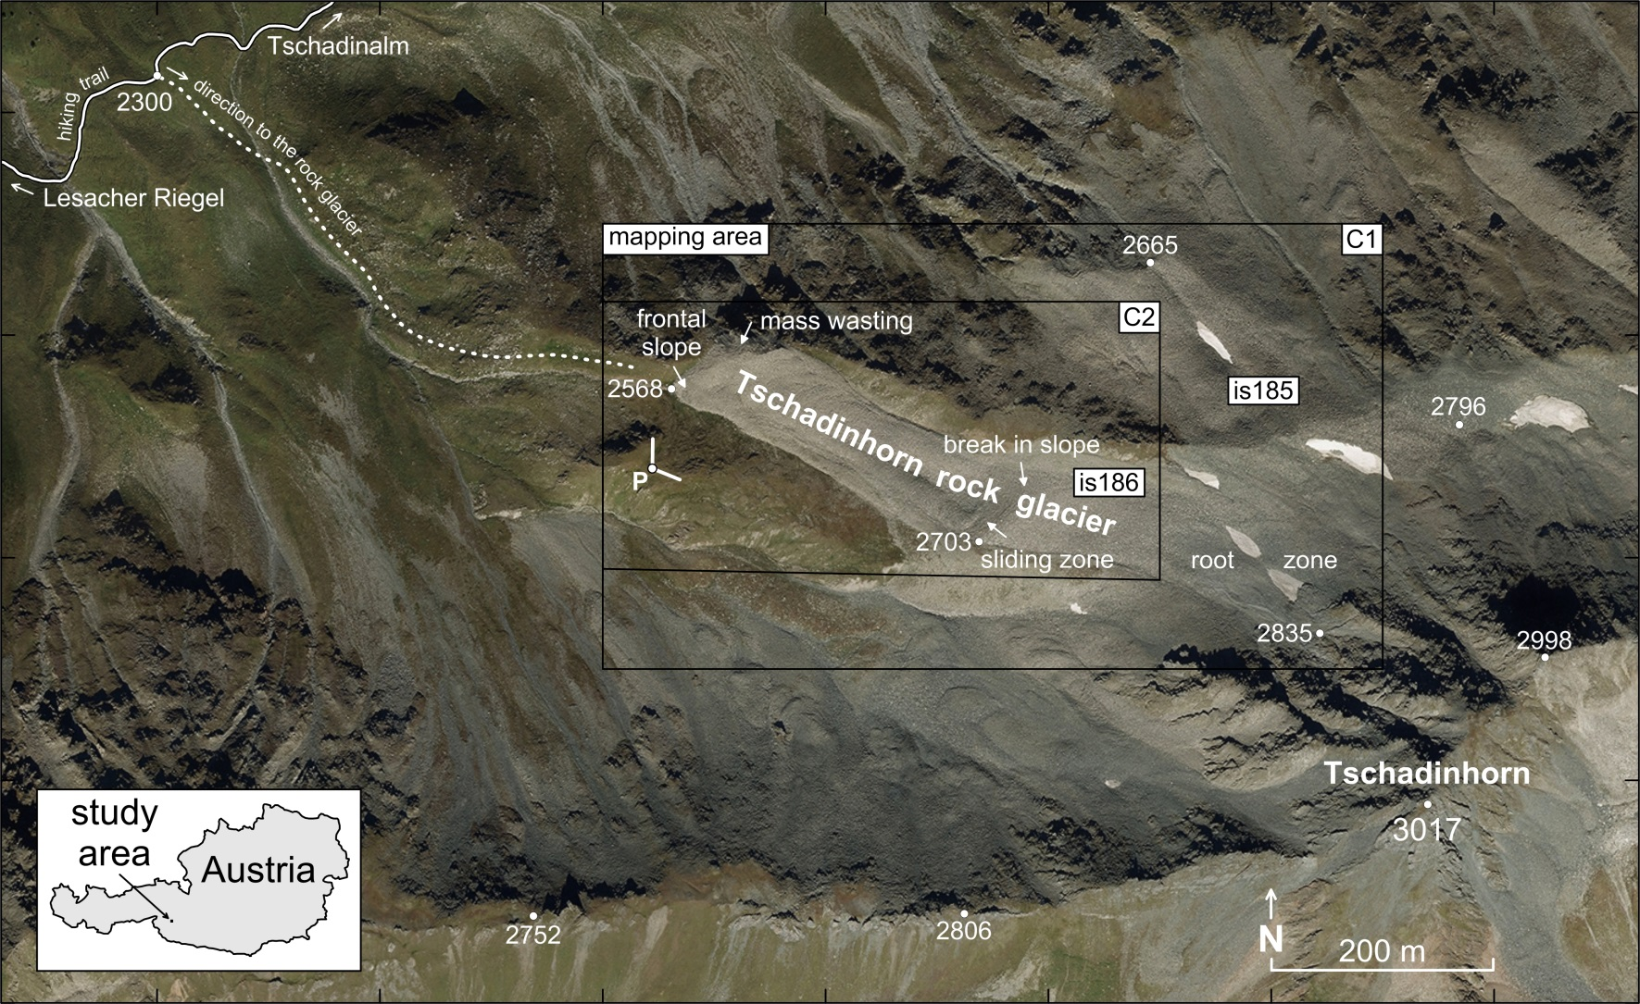
Panta rhei: Movement change of Tschadinhorn rock glacier (Hohe Tauern range, Austria) for the time period 1954-2017 2. Study area
Schober Mountains, Hohe Tauern NP
Orthophoto, 28.8.2015 © BEV & Land Tirol

Slide 5
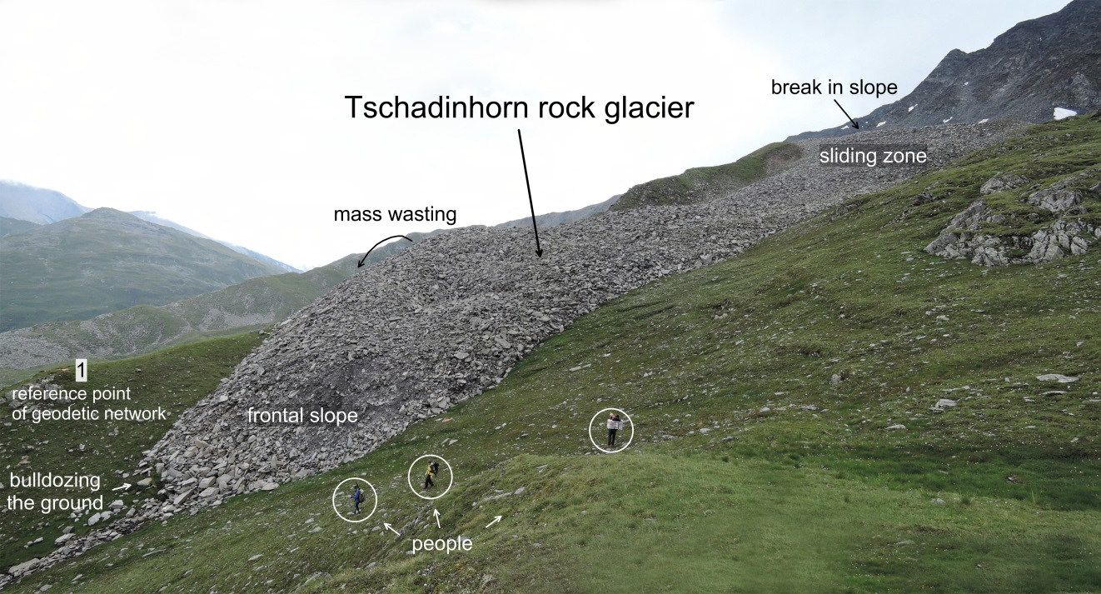
Panta rhei: Movement change of Tschadinhorn rock glacier (Hohe Tauern range, Austria) for the time period 1954-2017 2. Study area
Tschadinhorn rock glacier
Panoramic photo taken on 31.8.2015 by V. Kaufmann.

Slide 6
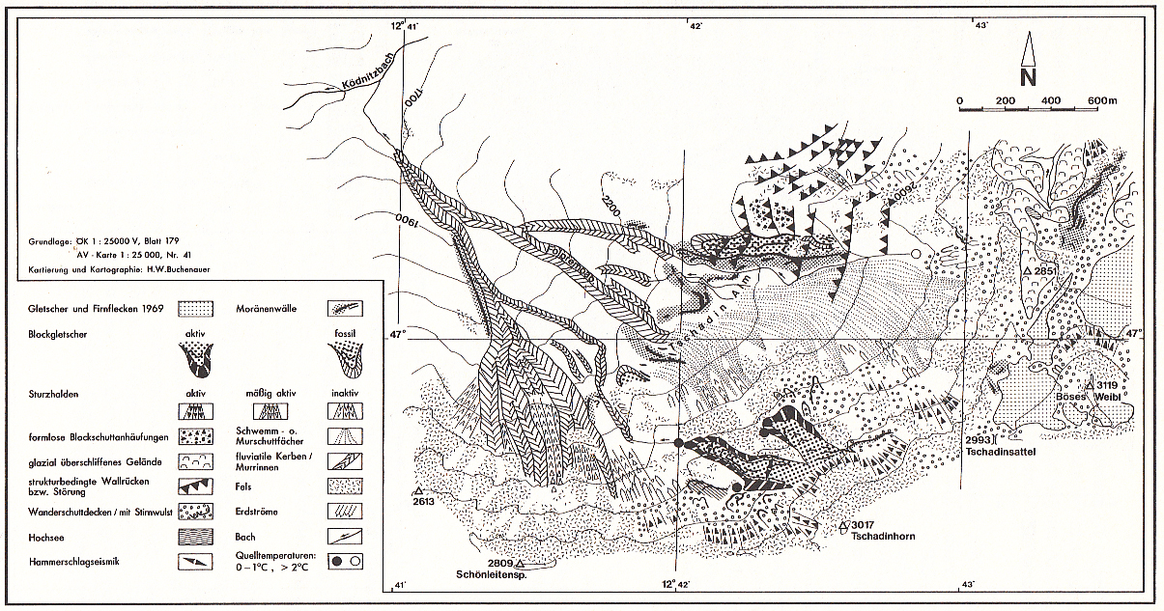
Panta rhei: Movement change of Tschadinhorn rock glacier (Hohe Tauern range, Austria) for the time period 1954-2017 3. Previous work
First permafrost studies
by Buchenauer (1990)
Source: Buchenauer (1990: p. 207)
Measurement of flow velocity
by Kaufmann (2010) using Google Maps and Microsoft Bing Maps, by Kaufmann and Kellerer-Pirklbauer (2015) using governmental GIS data, and by Filwarny and Wisiol (2012) and Mikl (2015) using original aerial photographs.

Slide 7
Panta rhei: Movement change of Tschadinhorn rock glacier (Hohe Tauern range, Austria) for the time period 1954-2017 4. Data
Metric aerial photographs 1954-2015
Date | Flying height above ground (m) | Camera type | Scale/ GSD* (cm) | Remark
24.9.1954 | 3250 | analog | 1:15,450/ 23 | b&w, fresh snow cover
29.9.1969 | 4345 | analog | 1:28,460/ 43 | b&w
6.9.1974 | 2080 | analog | 1:12,830/ 12 | b&w
9.10.1981 | 4660 | analog | 1:30,400/ 46 | b&w
18.9.1992 | 3000 | analog | 1:13,97/ 21 | false color IR
18.9.2002 | 4050 | analog | 1:13,280/ 20 | color
21.9.2006 | 4630 | analog | 1:15,250/ 23 | color
8.9.2009 | 4880 | analog | 1:15.970/ 24 | color
28.8.2012 | 2070 | digital | (1:22,450)/ 13 | R,G,B, NIR
28.8.2015 | 3060 | digital | (1:30,560)/ 16 | R,G,B, NIR
* … ground sampling distance

Slide 8
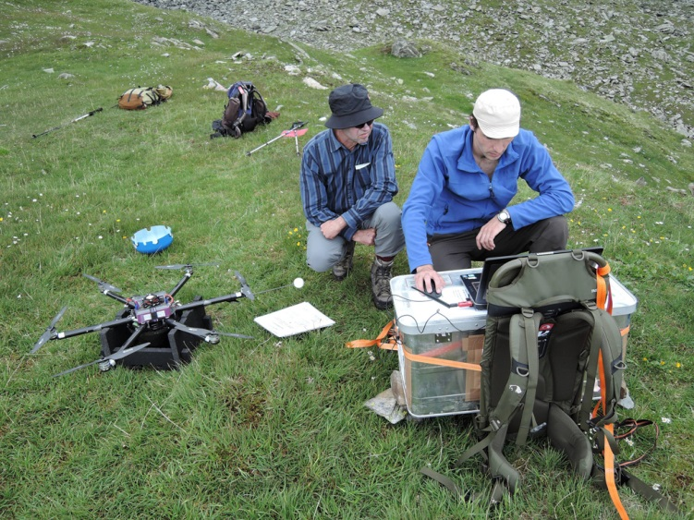
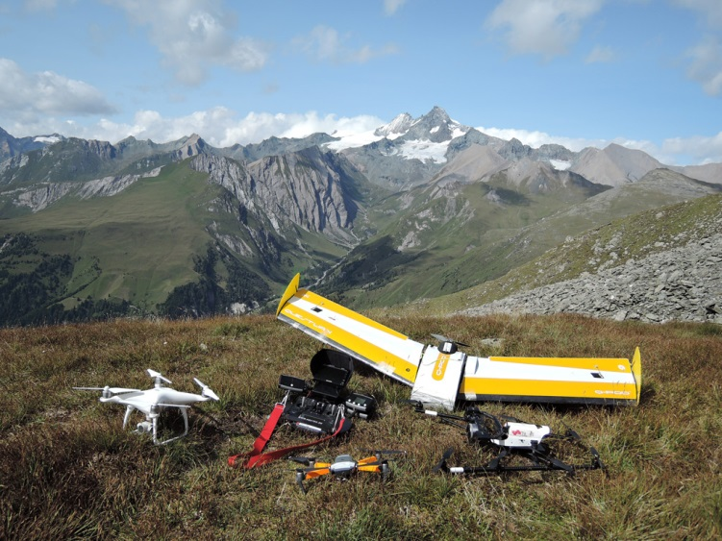
Panta rhei: Movement change of Tschadinhorn rock glacier (Hohe Tauern range, Austria) for the time period 1954-2017 4. Data
Non-metric aerial photographs 2016 and 2017
Date | UAS/UAV | Type | Number of photographs⁺ | Digital camera | GSD* (cm)
26.7.2016 | hexacopter twinHEX v.3.0 | rotary-wing | 13 (western part) 4 (eastern part) | Ricoh GXR A12 | 4.5 4.4
22.8.2017 | QuestUAV | fixed-wing | 68 | Sony ILCE-6000 | 5.1
⁺ … used in the photogrammetric mapping * … ground sampling distance
QuestUAV
Takeoff
Takeoff
Landing
twinHEX
Aerial survey 2016
Aerial survey 2017

Slide 9
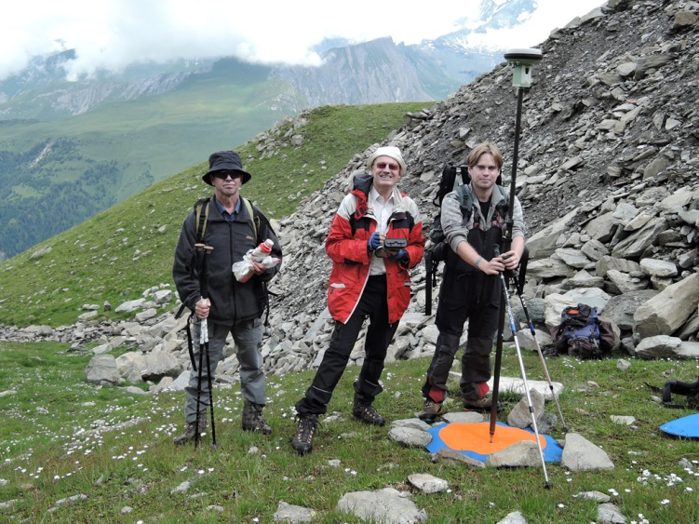
Panta rhei: Movement change of Tschadinhorn rock glacier (Hohe Tauern range, Austria) for the time period 1954-2017 4. Data
Geodetic measurements 2016 and 2017
Date | Number of points of the geodetic network |  | Number of additional points
 | on the rock glacier | outside the rock glacier | on the rock glacier | outside the rock glacier
27.7.2016 | 14 | 1 | 3 | 12
25.8.2016 | 14 | 4 | - | -
22.8.2017 | 14 | 3 | 6 | 18
Additional geodetic measurements from 2014 and 2015.
Measurement of a GCP using RTK-GNSS. Photo taken on 27.7.2016 by G. Seier.

Slide 10
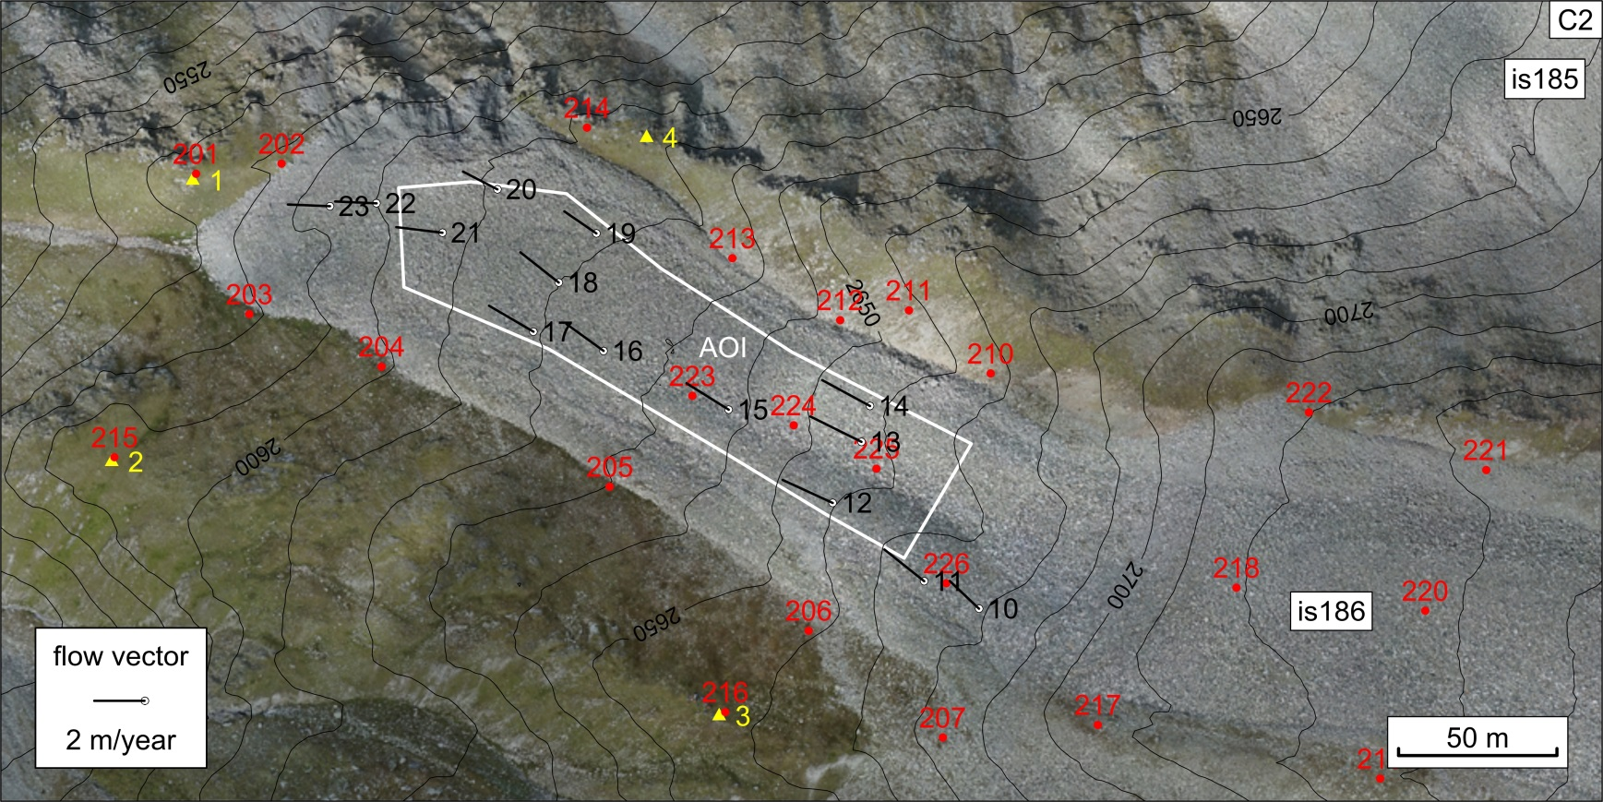
Panta rhei: Movement change of Tschadinhorn rock glacier (Hohe Tauern range, Austria) for the time period 1954-2017 4. Data
Flow vectors for 2016-2017
UAV-based orthophoto, 28.8.2017
yellow points: geodetic network, stable points white points: geodetic network, moving points
red points: temporarily marked ground control/check points of 28.8.2017

Slide 11
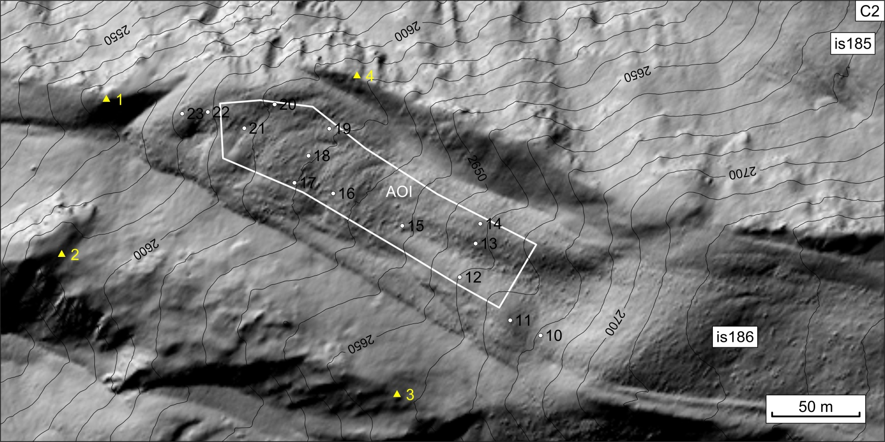
Panta rhei: Movement change of Tschadinhorn rock glacier (Hohe Tauern range, Austria) for the time period 1954-2017 4. Data
ALS data 2009
DSM, grid spacing: 1 m, 8.9.2009 © TIRIS, Land Tirol
yellow points: geodetic network, stable points white points: geodetic network, moving points

Slide 12
Panta rhei: Movement change of Tschadinhorn rock glacier (Hohe Tauern range, Austria) for the time period 1954-2017 5. Methods
Measurement of flow velocity
Orthophoto-based measurement
Metric data: ImageStation of Intergraph (orthophotos, DTMs)
UAV-based data: Agisoft PhotoScan applying SfM (orthophotos, DTMs)
Image matching (normalized cross-correlation coefficient)
Matlab-based toolbox
DTM-based measurement
Height field matching (normalized cross-correlation coefficient)
Velocity graph
Absolute/relative flow velocity

Slide 13
Panta rhei: Movement change of Tschadinhorn rock glacier (Hohe Tauern range, Austria) for the time period 1954-2017 6. Results
Horizontal movement
Time interval | Number of years | Precision⁺ of velocity data (cm/year) | Maximum flow velocity (cm/year) | Mapping area (coverage)
1954 - 1969 | 15.014 | ±1.9 | 59.5 | C1 (few points)
1969 - 1974 | 4.936 | ±4.5 | 38.0 | C1
1974 - 1981 | 7.091 | ±3.0 | 27.9 | C1
1981 - 1992 | 10.943 | ±2.2 | 35.6 | C1
1992 - 2002 | 9.999 | ±2.2 | 101.7 | C1
2002 - 2006 | 4.008 | ±2.3 | 119.6 | C1
2006 - 2009 | 2.965 | ±2.9 | 106.4 | C1
2009 - 2012 | 2.971 | ±3.1 | 199.0 | C1
2012 - 2015 | 2.998 | ±3.2 | 353.3 | C1
2015 - 2016 | 0.912 | ±6.2 (west), ±12.0 (east#) | 355.6 (west), 282.9 (east#) | C2 (2 parts)
2016 - 2017 | 1.073 | ±5.0 (west) | 230.0 (west) | C2 (western part)
2016 - 2017* | 1.073 | ±10.9 | 227.5 | C2 (both parts)
2009 - 2016* | 6.932 | ±3.3 | - | C2 (few points)
2009 - 2017* | 8.005 | ±2.6 | - | C2 (few points)
⁺ … standard deviation (SD, 1 σ) * … DTM-based solution # … The eastern part was georeferenced using landmarks measured in the stereomodels of 2015.

Slide 14
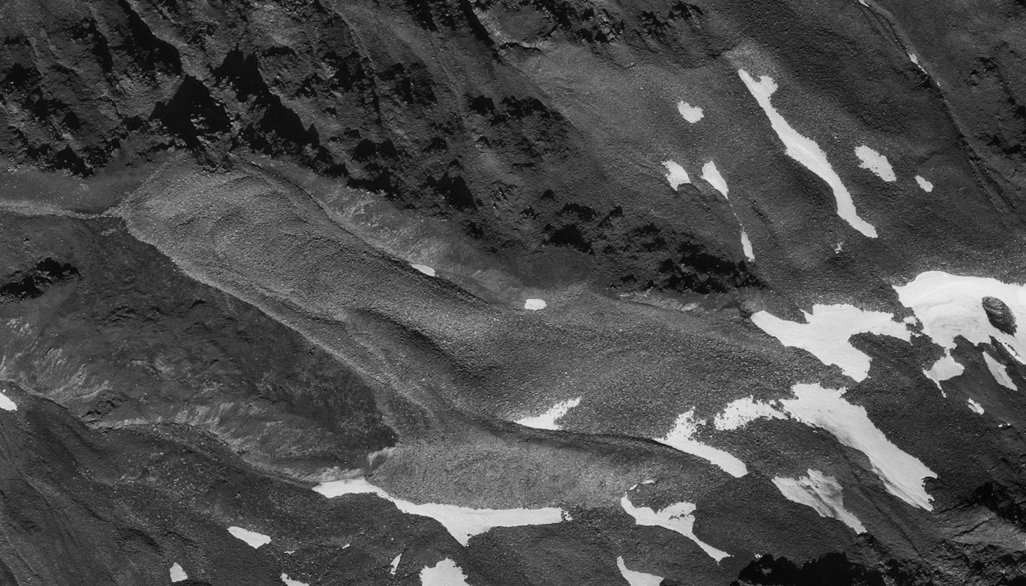
Panta rhei: Movement change of Tschadinhorn rock glacier (Hohe Tauern range, Austria) for the time period 1954-2017 6. Results
Time-lapse aerial photography 1974-2015
Epochs: 1974-1992-2002-2009-2012-2015
GSD: 25 cm

Slide 15
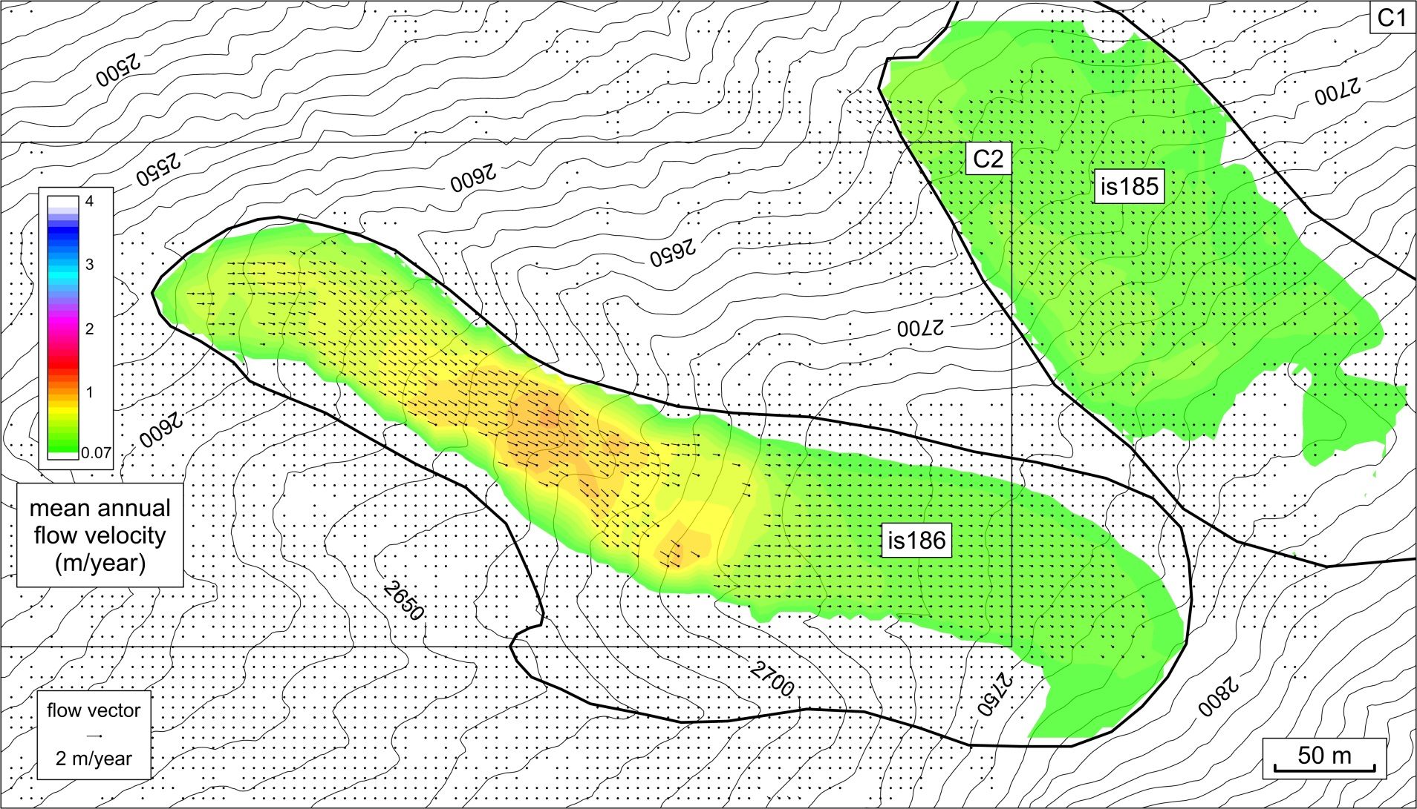
Panta rhei: Movement change of Tschadinhorn rock glacier (Hohe Tauern range, Austria) for the time period 1954-2017 6. Results
Mean annual horizontal flow velocity 1992-2002
Significance level at 3σ

Slide 16
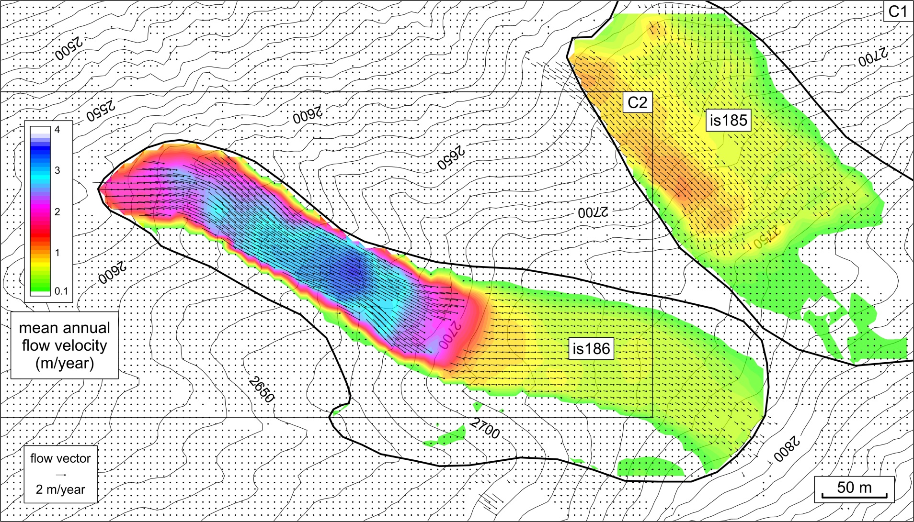
Panta rhei: Movement change of Tschadinhorn rock glacier (Hohe Tauern range, Austria) for the time period 1954-2017 6. Results
Mean annual horizontal flow velocity 2012-2015
Significance level at 3σ

Slide 17
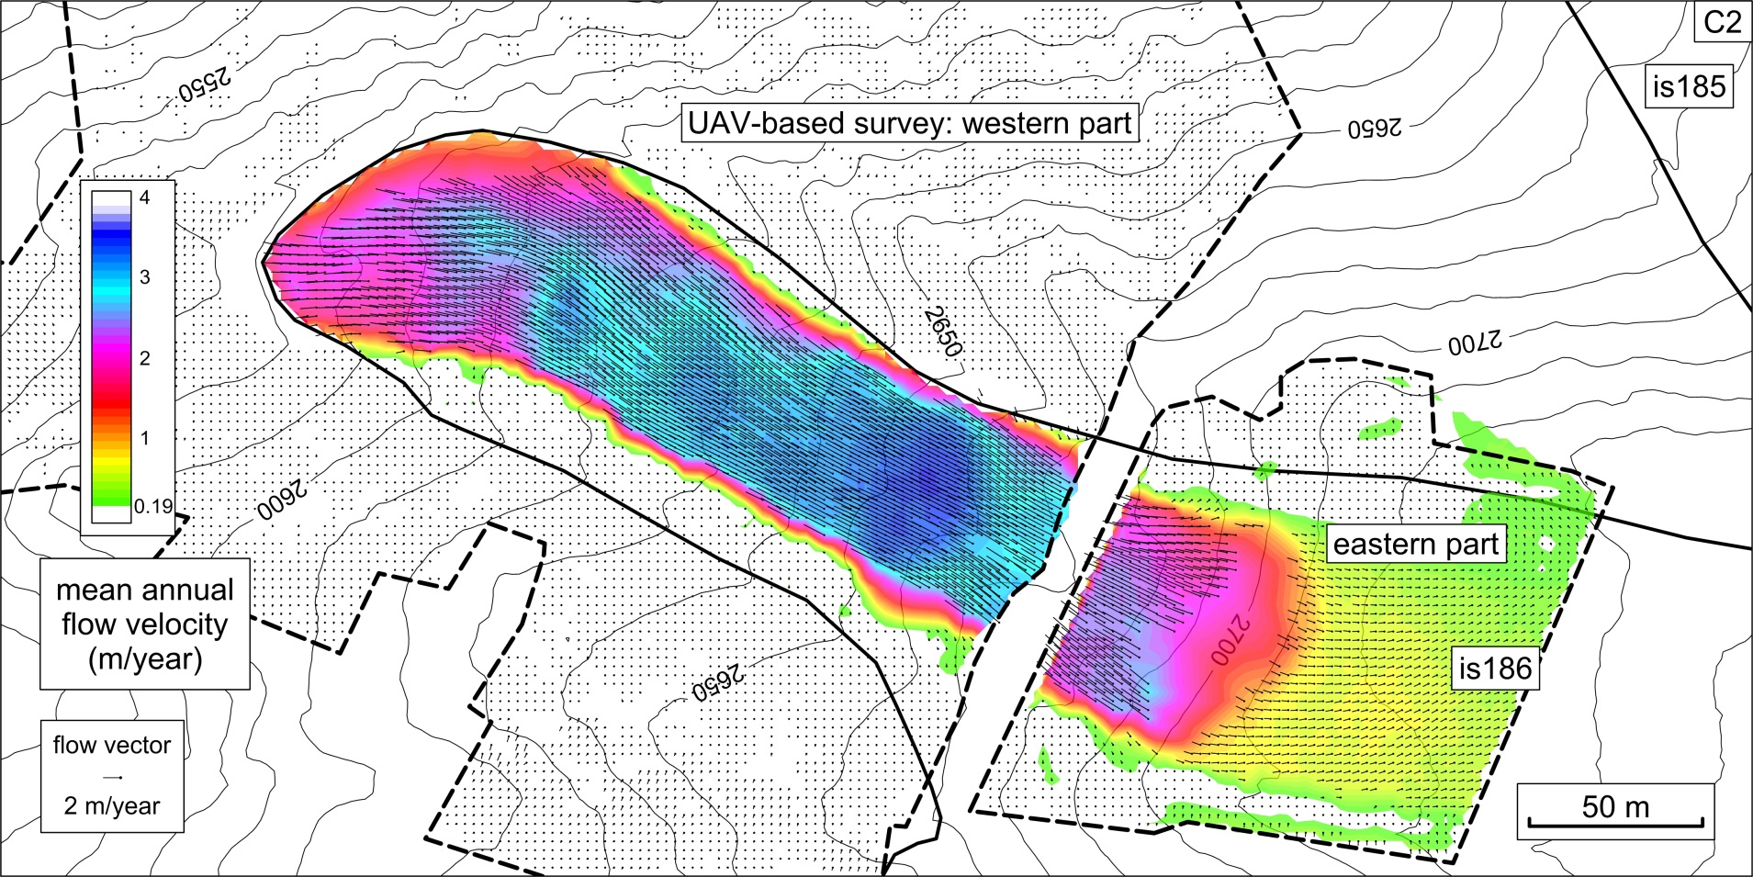
Panta rhei: Movement change of Tschadinhorn rock glacier (Hohe Tauern range, Austria) for the time period 1954-2017 6. Results
Mean annual horizontal flow velocity 2015-2016
Significance level at 3σ (valid for the western part)

Slide 18
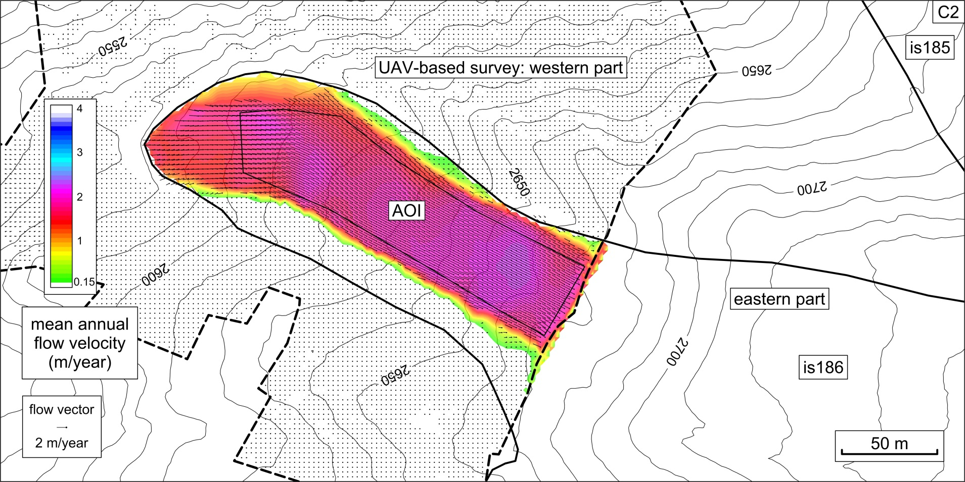
Panta rhei: Movement change of Tschadinhorn rock glacier (Hohe Tauern range, Austria) for the time period 1954-2017 6. Results
Mean annual horizontal flow velocity 2016-2017
Significance level at 3σ (valid for the western part) (UAV-based aerial surveys only)

Slide 19
Panta rhei: Movement change of Tschadinhorn rock glacier (Hohe Tauern range, Austria) for the time period 1954-2017 6. Results
Accuracy of the UAV-based velocity data
Time interval | Accuracy⁺ (m/year) of DOP-based flow velocity | Number of geodetic points used for accuracy analysis
28.8.2015 - 26.7.2016 | ±0.047 | 12
28.8.2015 - 22.8.2017 | ±0.032 | 14
26.7.2016 - 22.8.2017 | ±0.051/ ±0.028* | 12/ 13
⁺ … root mean square error (RMSE) * … DTM-based flow velocity

Slide 20
Panta rhei: Movement change of Tschadinhorn rock glacier (Hohe Tauern range, Austria) for the time period 1954-2017 6. Results
Height accuracies of selected multi-temporal DTMs
Date | Height accuracy⁺ (m) of DTM
24.9.1954 | ±0.42
6.9.1974 | ±0.17
18.9.1992 | ±0.16
8.9.2009 | height reference (ALS data)
28.8.2015 | ±0.12
26.7.2016 | ±0.09/ ±0.09* (30 points)
22.8.2017 | ±0.07/ ±0.06* (42 points)
⁺ … standard deviation (SD, 1 σ) * … value derived from known geodetic points

Slide 21
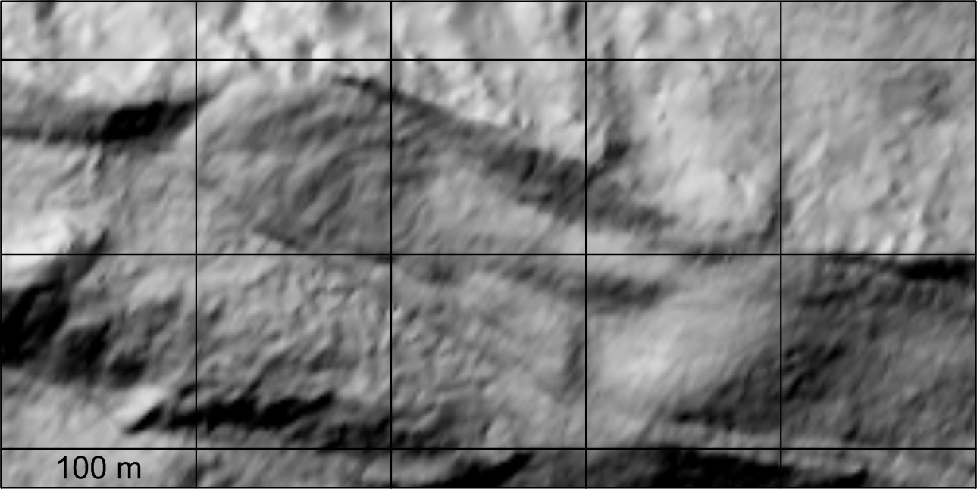
Panta rhei: Movement change of Tschadinhorn rock glacier (Hohe Tauern range, Austria) for the time period 1954-2017 6. Results
Time-lapse relief change 1954-2017
Epochs: 1954-1974-1992-2002-2006-2009-2012-2015-2017 Grid spacing of DTM : 2 m

Slide 22
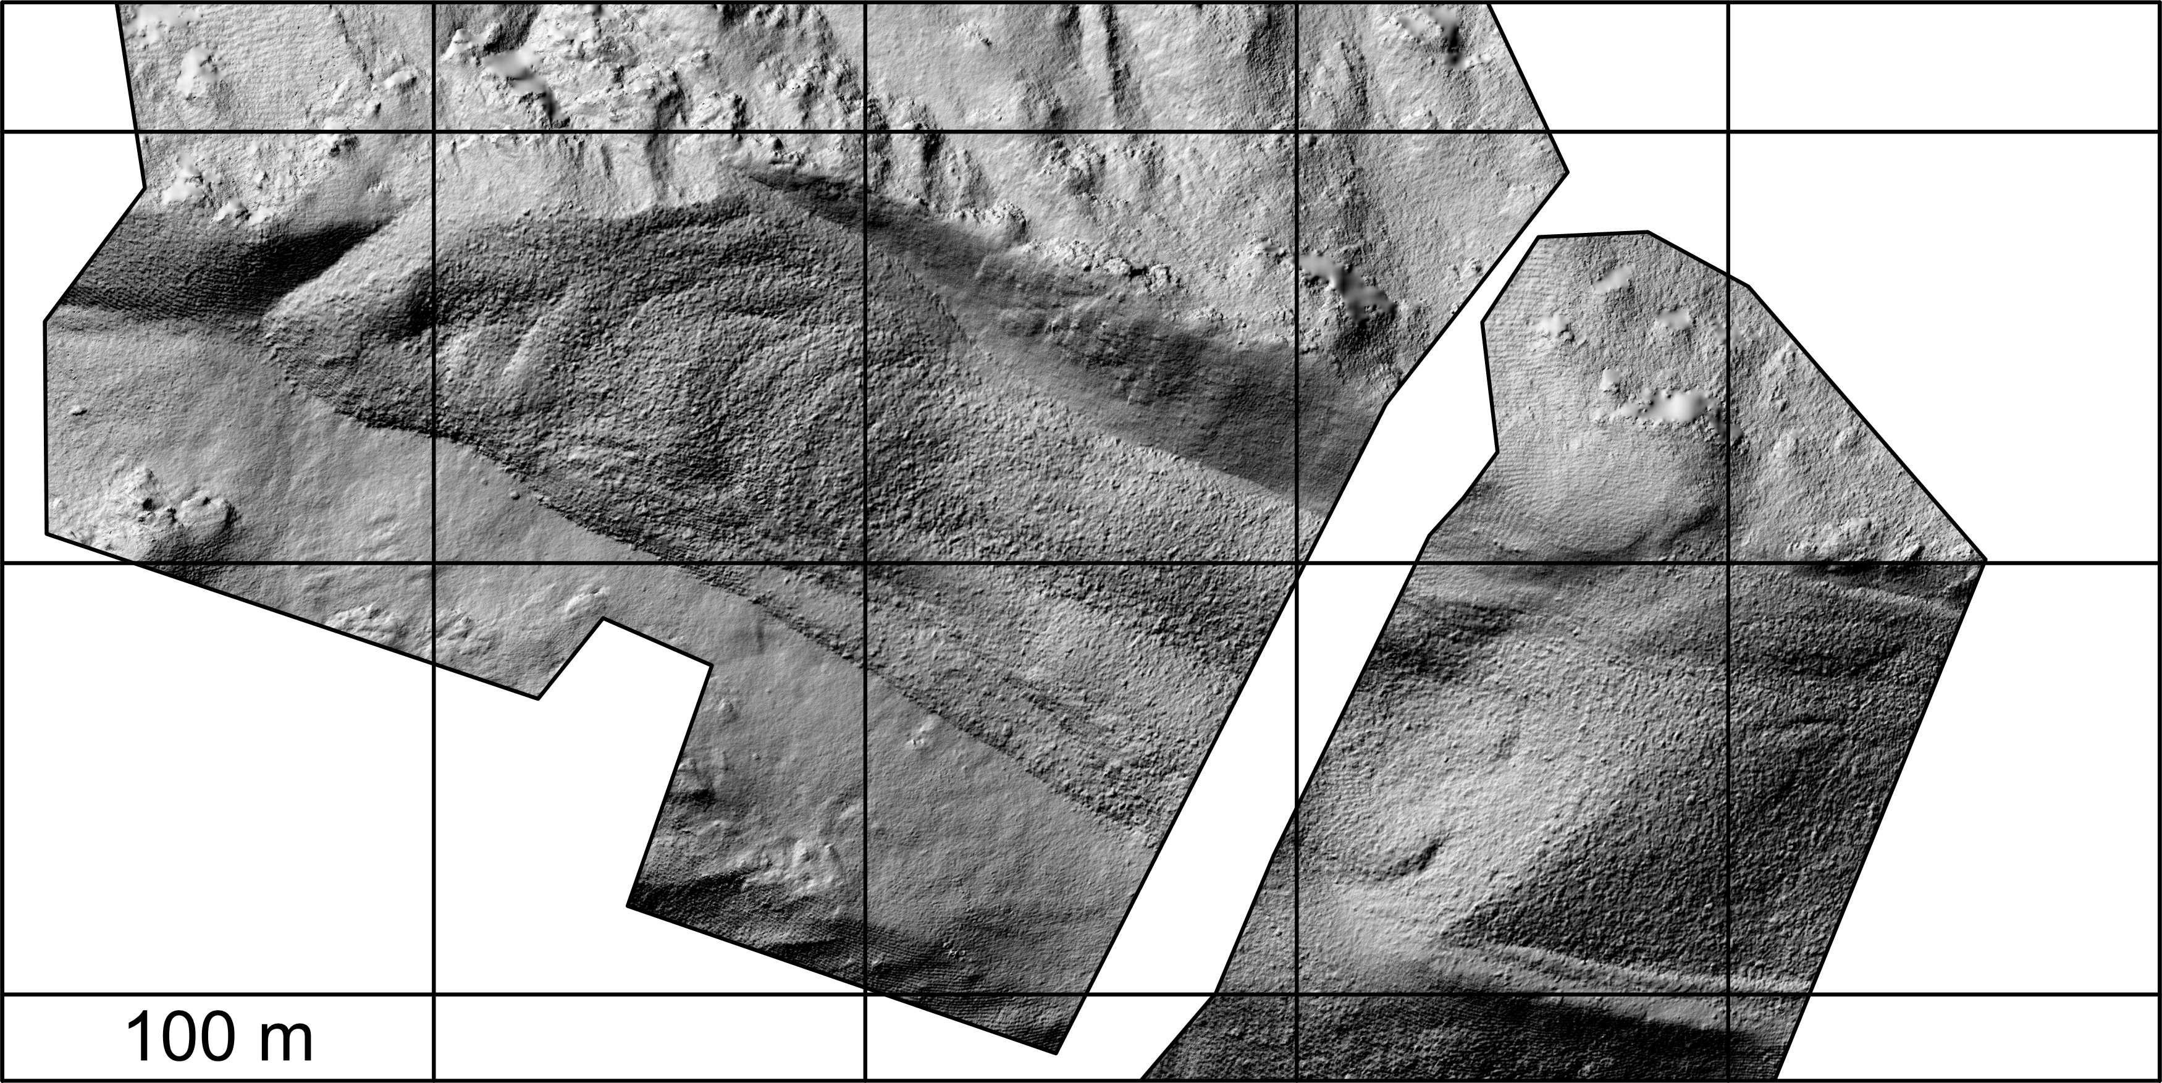
Panta rhei: Movement change of Tschadinhorn rock glacier (Hohe Tauern range, Austria) for the time period 1954-2017 6. Results
Time-lapse relief change 2016-2017
Epochs: 2016 and 2017 (UAV-based aerial surveys only)
Grid spacing of DTM: 20 cm

Slide 23
Panta rhei: Movement change of Tschadinhorn rock glacier (Hohe Tauern range, Austria) for the time period 1954-2017 6. Results
Numerical values of the velocity graph 1954-2917
Time interval | Mean annual horizontal flow velocity⁺ (m/year) | Relative value (%) in respect to 2014-2015
24.9.1954 - 29.9.1969 | 0.433 | 13.18
29.9.1969 - 6.9.1974 | 0.162 | 4.95
6.9.1974 - 9.10.1981 | 0.175 | 5.32
9.10.1981 - 18.9.1992 | 0.224 | 6.83
18.9.1992 - 18.9.2002 | 0.749 | 22.82
18.9.2002 - 21.9.2006 | 0.941 | 28.68
21.9. 2006 - 8.9.2009 | 0.794 | 24.20
8.9.2009 - 28.8.2012 | 1.631 | 49.71
28.8.2012 - 2.8.2014 | 2.550# | 77.72
2.8.2014 - 28.8.2015 | 3.282* | 100.00
28.8.2015 - 26.7.2016 | 2.911 | 88.72
26.7.2016 - 22.8.2017 | 1.925 | 58.65
⁺ … area average referring to AOI * … RTK-GNSS measurements scaled to AOI
# … value derived from velocity data
2012-2015 and 2014-2015

Slide 24
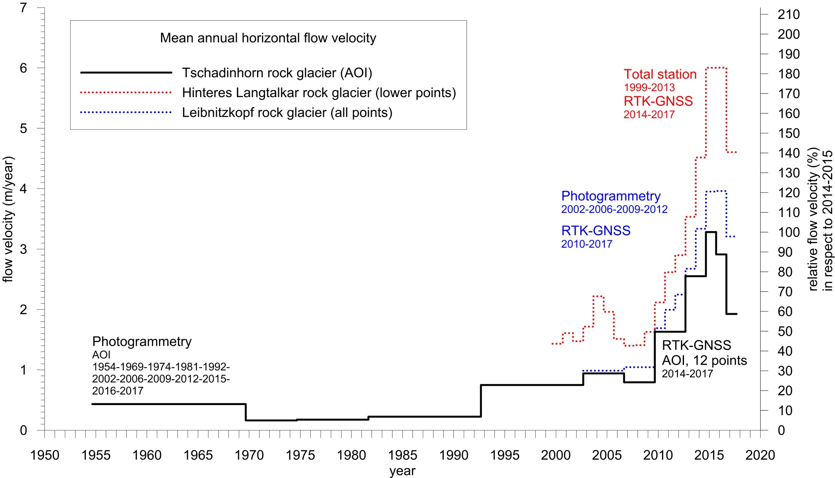
Panta rhei: Movement change of Tschadinhorn rock glacier (Hohe Tauern range, Austria) for the time period 1954-2017 6. Results
Velocity graph 1954-2017 of Tschadinhorn rock glacier

Slide 25
Panta rhei: Movement change of Tschadinhorn rock glacier (Hohe Tauern range, Austria) for the time period 1954-2017 7. Discussion
Tschadinhorn rock glacier was moving throughout the whole observation period of 63 years, albeit at different activity levels.
A maximum flow velocity of 3.28 m/year was obtained for 2014-2015,
whereas the lowest flow velocity of 0.16 m/year was observed for 1969-1974.
The time span 1954-2009 is characterized by generally moderate activity (0.16 - 0.79 m/year)
and much higher flow velocities prevail from 2009.
The present value for 2016-2017 is 1.92 m/year.
Since 1954 the front of the rock glacier has advanced 29.5 m, which amounts to an average velocity of approx. 0.47 m/year.
Flow velocities derived from UAV data were verified by geodetic measurements and high accuracies in the order of ±3-5 cm/year (1 σ) were reached.
DTM-based flow velocities correlate well with DOP-based ones only in case of fine grid-spacing (≤ 10 cm).
The standards of conventional photogrammetric mapping of governmental agencies, e.g., BEV, could be reached easily, provided that sufficient ground control points are available and GSD of the image data is better than 5 cm.
UAV-based aerial surveys have also the potential to support intra-annual change detection analyses.
The flow velocities obtained will be correlated with climatic parameters in a follow-on study.

Slide 26
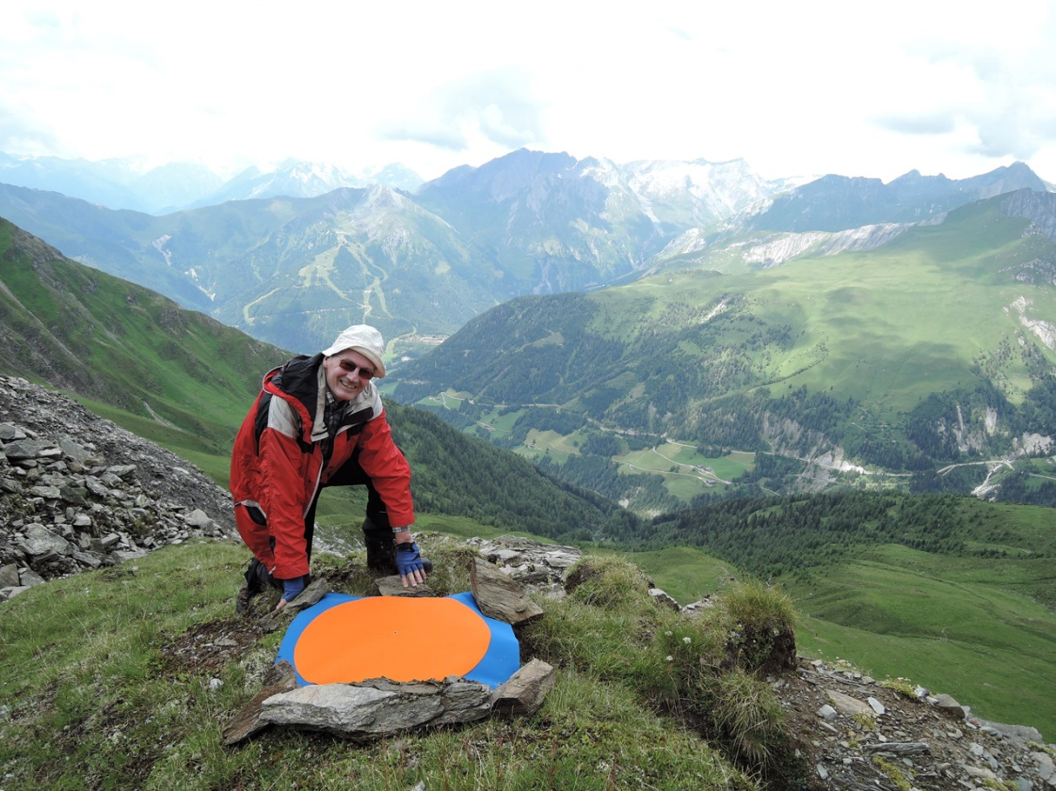
Panta rhei: Movement change of Tschadinhorn rock glacier (Hohe Tauern range, Austria) for the time period 1954-2017
Thank you for your attention!
V. Kaufmann, 26.7.2016

