Slide 1
20 Years of Geodetic Monitoring of Dösen Rock Glacier (Ankogel Group, Austria) – A Short Review
V. Kaufmann Institute of Geodesy Working Group Remote Sensing and Photogrammetry Graz University of Technology, Austria E-mail: viktor.kaufmann@tugraz.at http://www.geoimaging.tugraz.at/viktor.kaufmann/

Slide 2
20 Years of Geodetic Monitoring of Dösen Rock Glacier (Ankogel Group, Austria) – A Short Review
Contents 1. Introduction 2. Total Station Measurements 1995-2013 3. GPS/GNSS Measurements 2014-2015 4. Photogrammetric Measurements 5. Results 6. Conclusions and Outlook

Slide 3
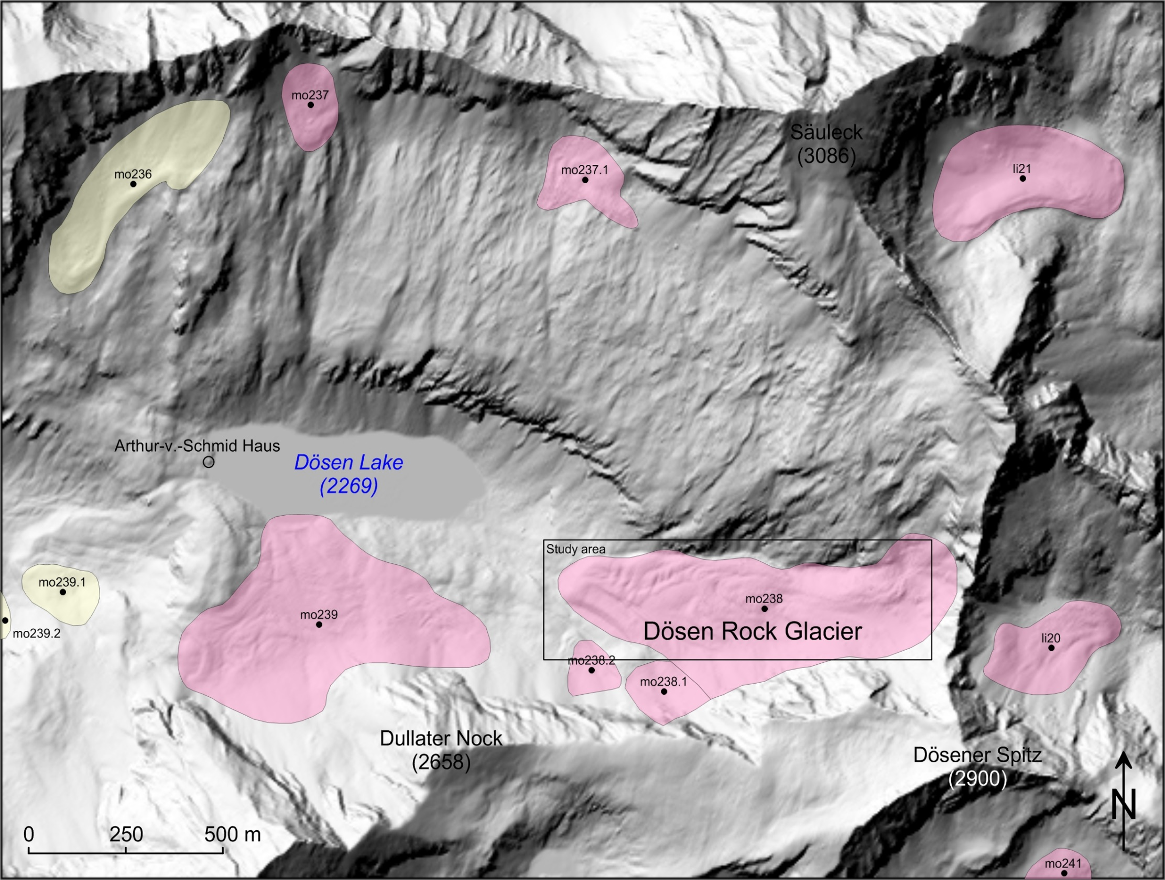
20 Years of Geodetic Monitoring of Dösen Rock Glacier (Ankogel Group, Austria) – A Short Review 2. Total station measurements 1995-2013
Rock glacier inventory (Kellerer-Pirklbauer et al. 2014)

Slide 4
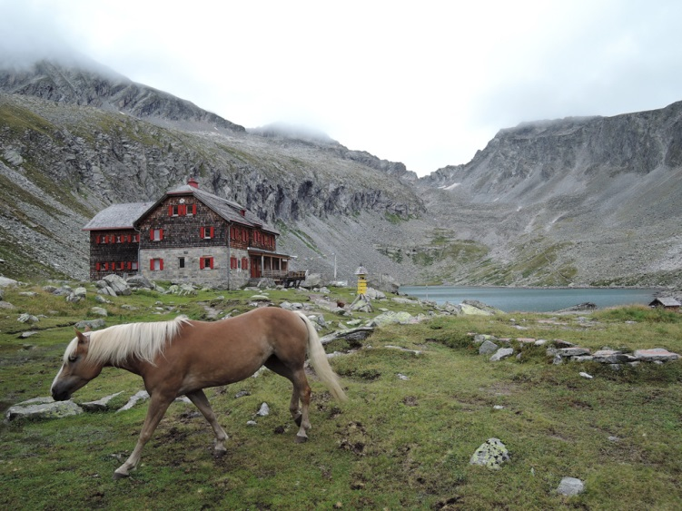
20 Years of Geodetic Monitoring of Dösen Rock Glacier (Ankogel Group, Austria) – A Short Review 1. Introduction
Arthur-v.-Schmid Haus (2275 m)
Dösen rock glacier
Dösen Lake (2269 m)
August 17, 2015

Slide 5
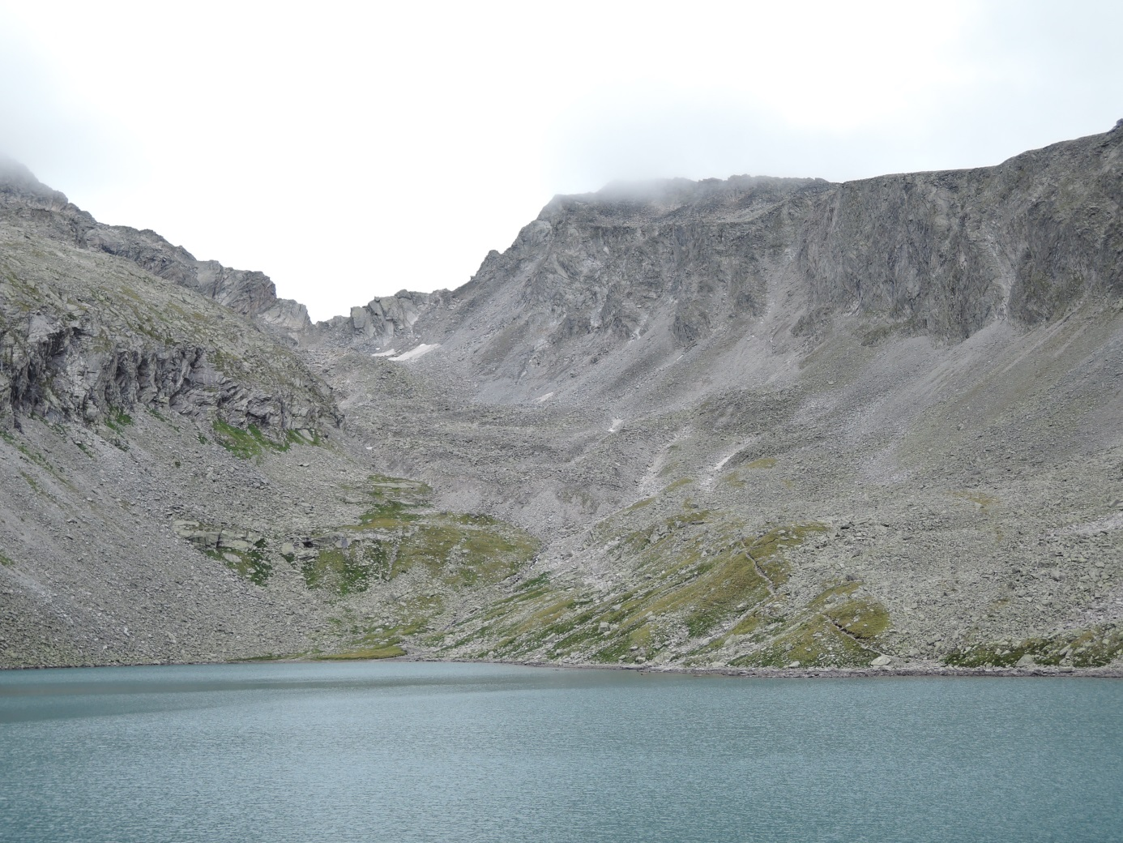
20 Years of Geodetic Monitoring of Dösen Rock Glacier (Ankogel Group, Austria) – A Short Review 1. Introduction
2900
●
2674
●
2339
●
2269 m
August 17, 2015

Slide 6
20 Years of Geodetic Monitoring of Dösen Rock Glacier (Ankogel Group, Austria) – A Short Review 1. Introduction
(1) Rigid body movement
Classical deformation analysis
(2) Affine deformation
t₂
dX₁₂
t₁
Object
Stable reference frame
… Stable reference points … Observation points

Slide 7
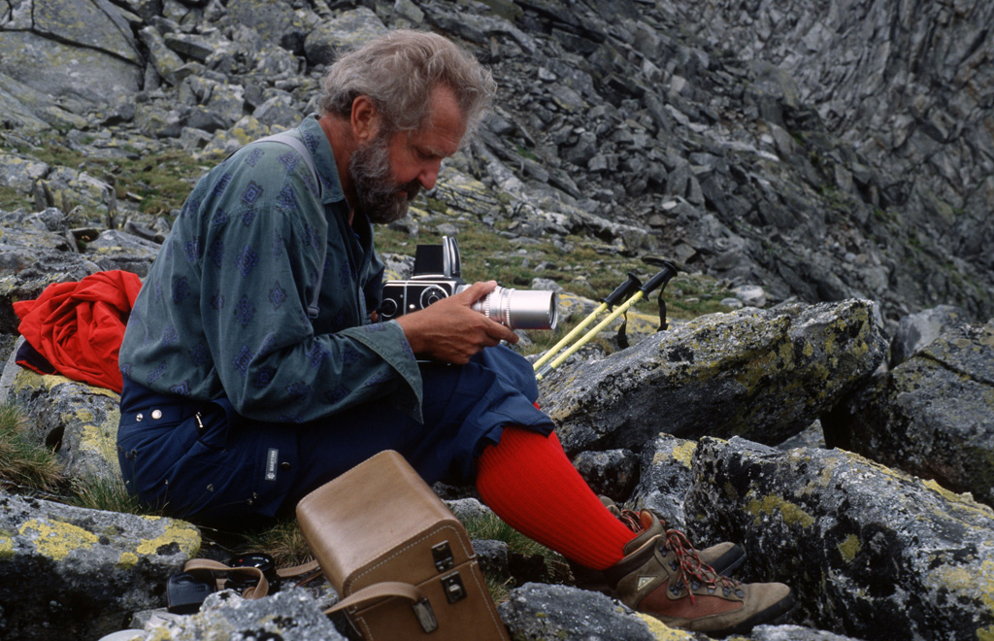
20 Years of Geodetic Monitoring of Dösen Rock Glacier (Ankogel Group, Austria) – A Short Review 1. Introduction
July 26, 1994
A first visit to Dösen rock glacier

Slide 8
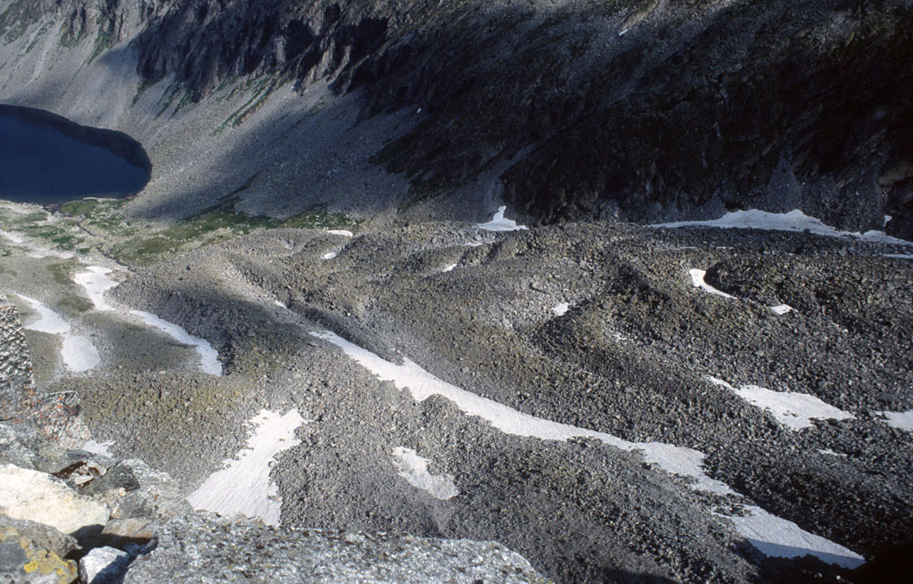
20 Years of Geodetic Monitoring of Dösen Rock Glacier (Ankogel Group, Austria) – A Short Review 1. Introduction
July 26, 1994

Slide 9
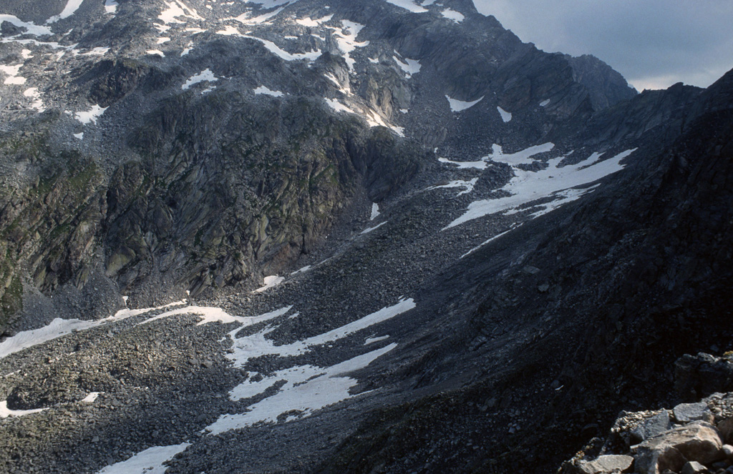
20 Years of Geodetic Monitoring of Dösen Rock Glacier (Ankogel Group, Austria) – A Short Review 1. Introduction
July 26, 1994

Slide 10
20 Years of Geodetic Monitoring of Dösen Rock Glacier (Ankogel Group, Austria) – A Short Review 2. Total Station Measurements 1995-2013
Set-up of a geodetic network and initial (zero) measurement in 1995
7 stable reference points marked with brass bolts & 3 points of BEV
3 additional points (N5, N6 and N7) were added in later stage.
107 observation points on the rock glacier
34 points marked with brass bolts
4 profiles (107 points in total, marked with hammer and chisel)
2 longitudinal profiles
2 transversal profiles
Measurement of the stable reference frame
Total station (1995, …)
GPS (1996, …)
Initial (zero) measurement of the observation points
Total station (1995)
Annual measurements in August

Slide 11
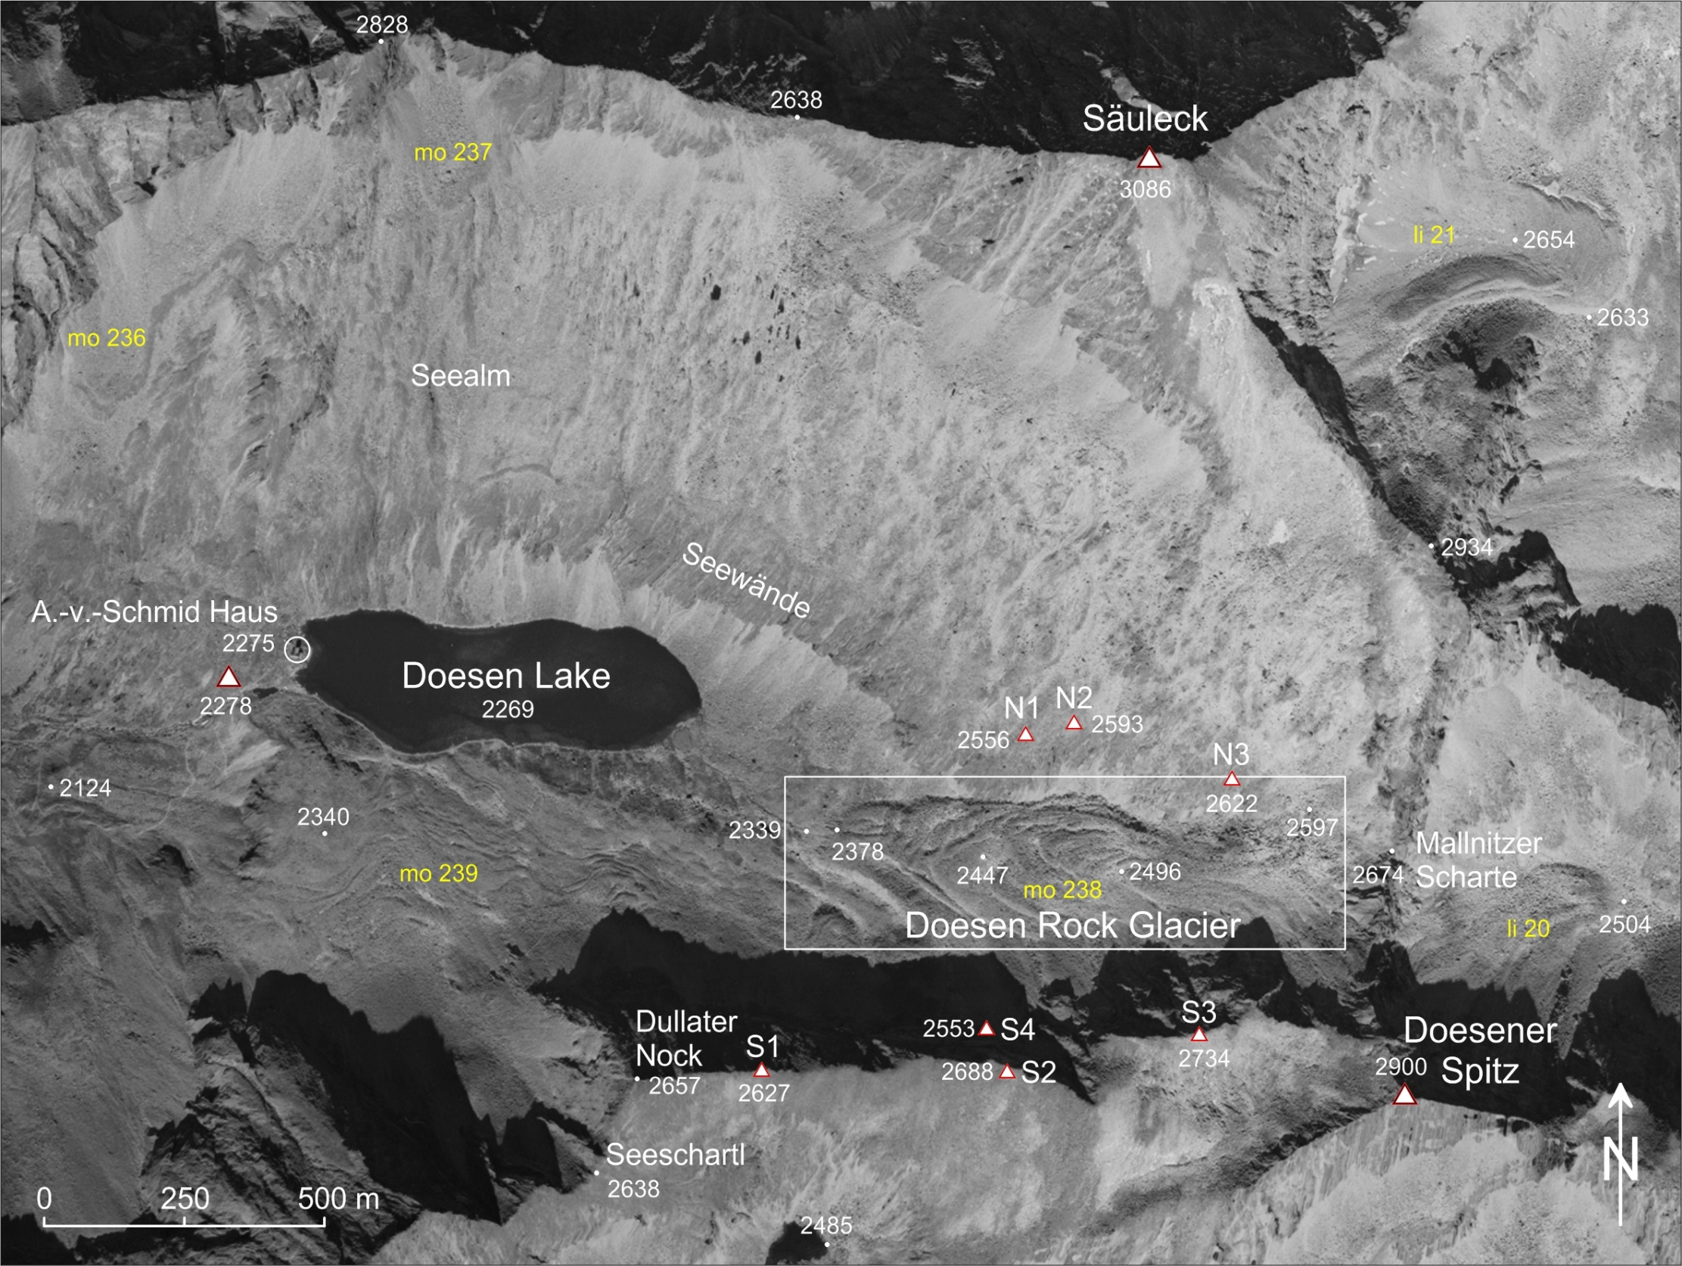
20 Years of Geodetic Monitoring of Dösen Rock Glacier (Ankogel Group, Austria) – A Short Review 2. Total station measurements 1995-2013

Slide 12
20 Years of Geodetic Monitoring of Dösen Rock Glacier (Ankogel Group, Austria) – A Short Review 2. Total Station Measurements 1995-2013
34 observation points marked with brass bolts
4 profiles: 1000-1015, 2000-2011, 3000-3026, 4000-4016, and additional 3 points 1016, 5001 and 5002

Slide 13
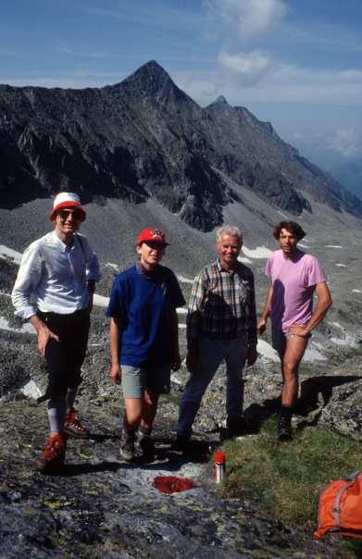
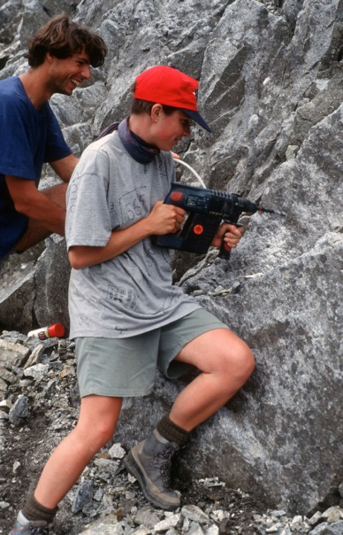
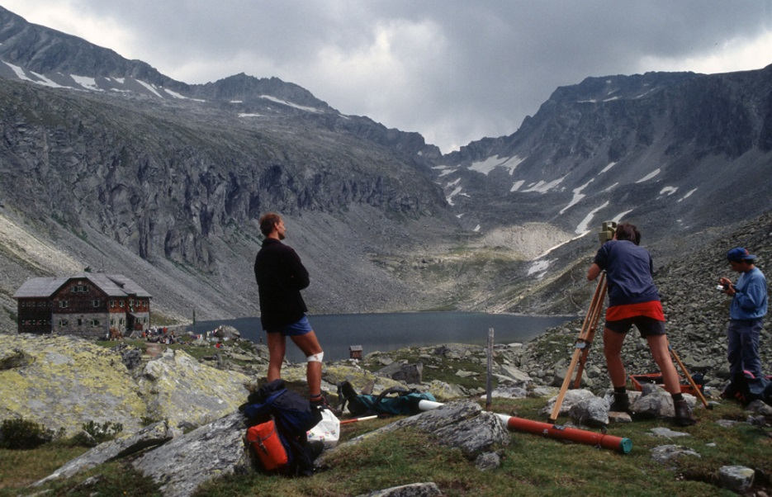
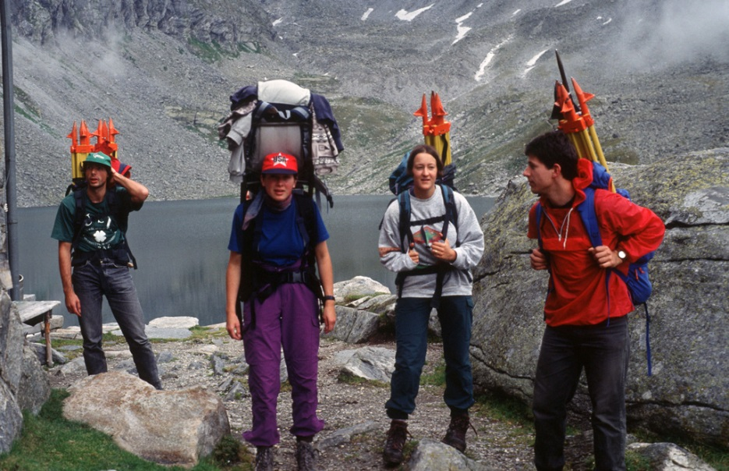
20 Years of Geodetic Monitoring of Dösen Rock Glacier (Ankogel Group, Austria) – A Short Review 2. Total Station Measurements 1995-2013
Gerhard Kienast at point S1
July 26-28, 1995
Kaufmann, Tilg, Kienast, Heiland
Check point at S4
Geodetic survey at the triangulation point AVS
August 12-15, 1997
Transport of heavy geodetic equipment
August 13-21, 1995

Slide 14
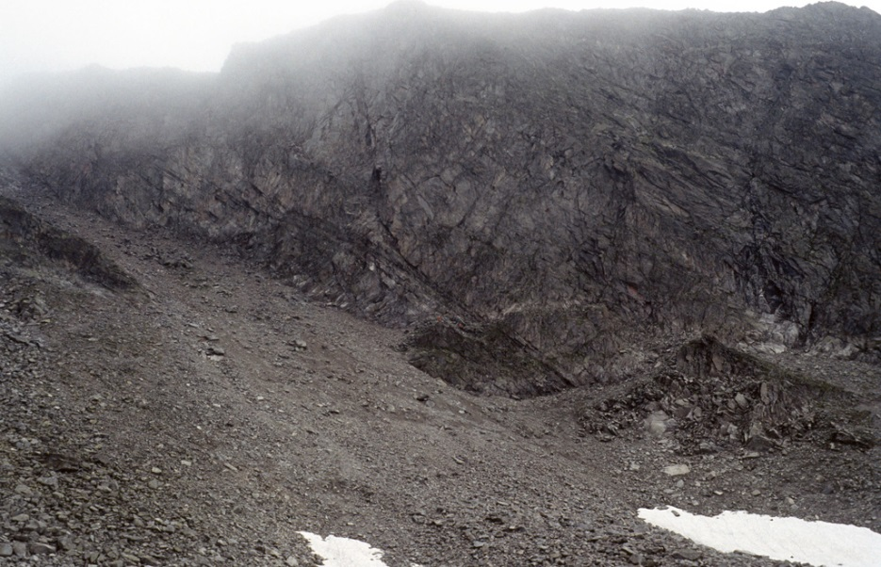
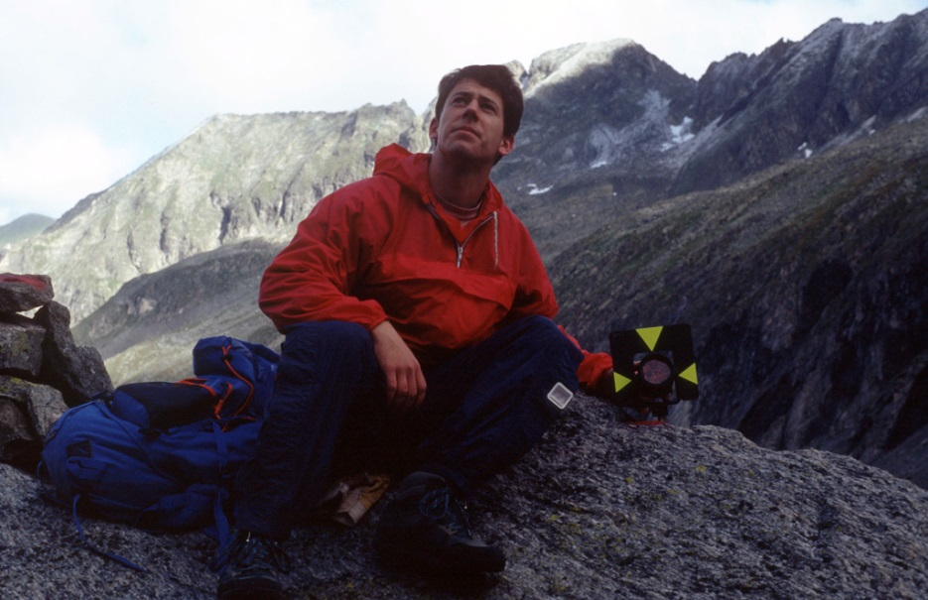
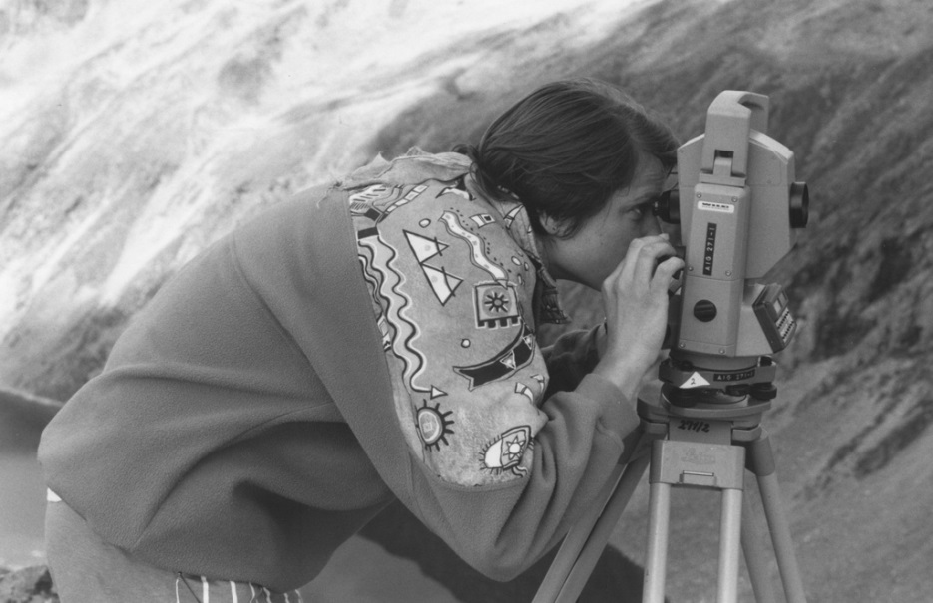
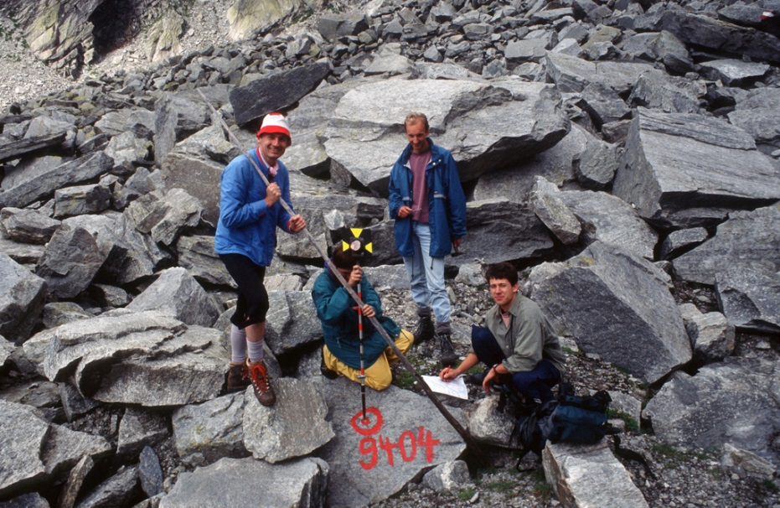
20 Years of Geodetic Monitoring of Dösen Rock Glacier (Ankogel Group, Austria) – A Short Review 2. Total Station Measurements 1995-2013
S4
Reflector put on brass bolt
Polar method surveying from point S4
August 13-21, 1995
August 13-21, 1995
August 5-11, 1996
August 13-21, 1995

Slide 15
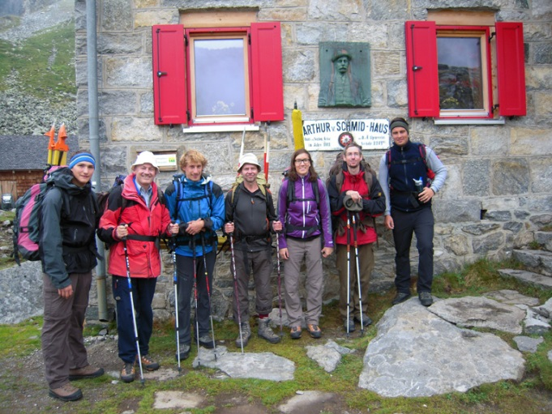
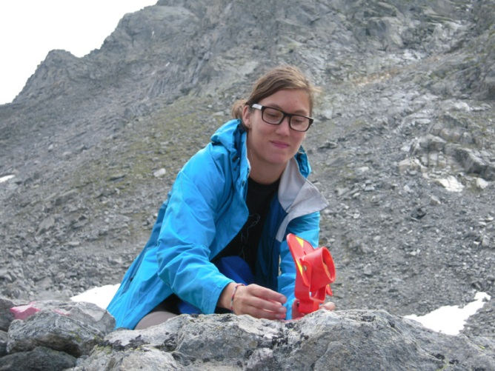
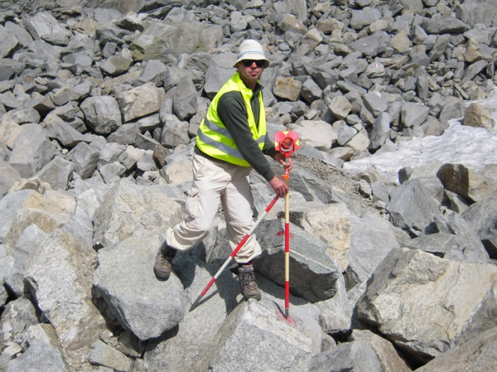
20 Years of Geodetic Monitoring of Dösen Rock Glacier (Ankogel Group, Austria) – A Short Review 2. Total Station Measurements 1995-2013
Annual repeat measurements between 1996 and 2013
No measurements were carried out in 2003 because of financial constraints.
Measurements using a total station terminated in 2013.
Surveying team 2013
August 12-14, 2013

Slide 16
20 Years of Geodetic Monitoring of Dösen Rock Glacier (Ankogel Group, Austria) – A Short Review 2. Total Station Measurements 1995-2013
Assessment:
High accuracy: m_{X} = m_{Y} = m_{Z} = ±1 cm
Fast (1 day)
Independent measurement technique (no third-party service is needed)
Experienced operator is needed for the total station.
Strong dependency on the weather (visibility)
Personnel intensive (5-6 persons)
Physically strong helpers needed
High costs because of the personnel
Difficult and dangerous climb to reach point S4
S4 is not stable but gradually moving downward.

Slide 17
20 Years of Geodetic Monitoring of Dösen Rock Glacier (Ankogel Group, Austria) – A Short Review 2. Total Station Measurements 1995-2013
2D displacement vectors 2012-2013

Slide 18
20 Years of Geodetic Monitoring of Dösen Rock Glacier (Ankogel Group, Austria) – A Short Review 3. GPS/GNSS Measurements 2014-2015
GNSS-based surveying since 2014
2014: Validation of the real-time kinematic (RTK) positioning technique at Dösen rock glacier.
Reference station (base): Triangulation point (AVS) near Arthur-v.-Schmid Haus
Additional stable points M1, M2 and M3 for ease of work
Equipment used: Leica Viva GNSS
Accuracy: 2-3 times inferior to the classical method used previously
2015: RTK-GNSS measurements only

Slide 19
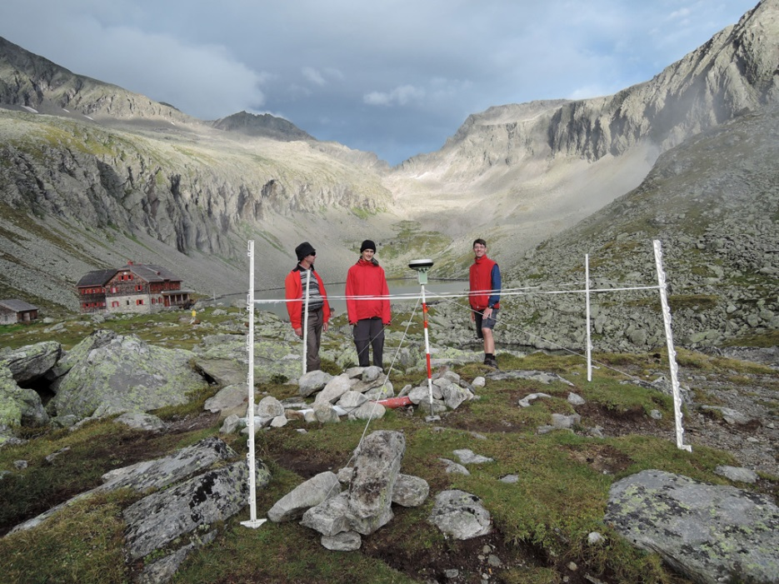
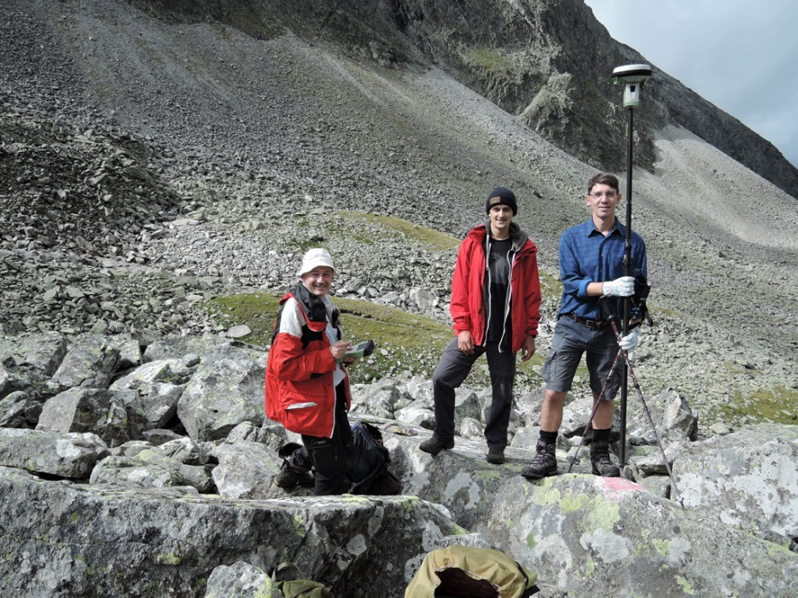
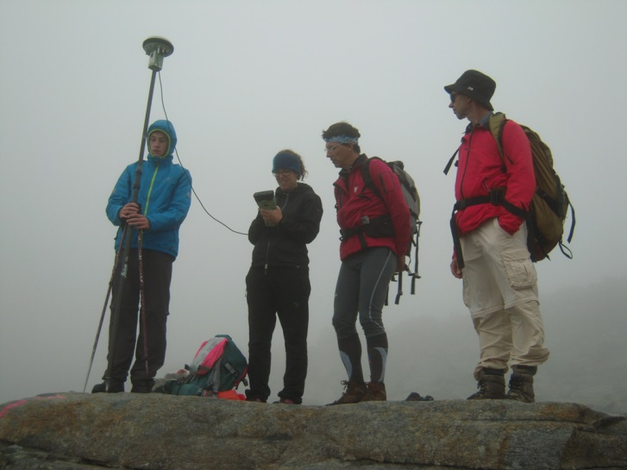
20 Years of Geodetic Monitoring of Dösen Rock Glacier (Ankogel Group, Austria) – A Short Review 3. GPS/GNSS Measurements 2014-2015
Reference point (AVS) (2278 m)
August 18, 2015
August 18, 2015
August 12, 2014

Slide 20
20 Years of Geodetic Monitoring of Dösen Rock Glacier (Ankogel Group, Austria) – A Short Review 3. GPS/GNSS Measurements 2014-2015
Assessment:
Less personnel needed (2-4 persons)
More cost-efficient
Measurement is independent of weather conditions (visibility).
Measurements can be carried out by anybody after a short training.
Adequate accuracy: m_{X} = m_{Y} = m_{Z} = ±2-3 cm (= ~10% relative accuracy in respect to the average annual flow velocity)
Daily output of measured points is limited. On a fine day all 34 observation points can be measured within 1 day.
Thus, the measurement of the 4 profiles had to be abandoned.
Possible problems with bad satellite constellation, signal shadowing, and multipath effects

Slide 21
20 Years of Geodetic Monitoring of Dösen Rock Glacier (Ankogel Group, Austria) – A Short Review 3. GPS/GNSS Measurements 2014-2015
2D displacement vectors 2014-2015

Slide 22
20 Years of Geodetic Monitoring of Dösen Rock Glacier (Ankogel Group, Austria) – A Short Review 4. Photogrammetric Measurements
Computer animation: 1969 – 1998 – 2010
Horizontal movement of Dösen rock glacier

Slide 23
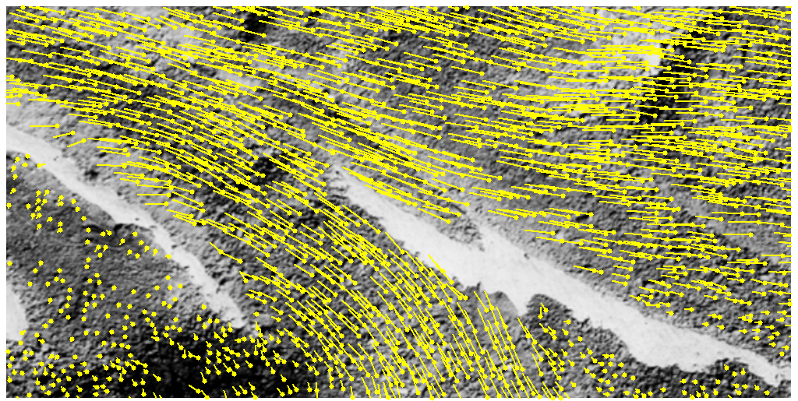
20 Years of Geodetic Monitoring of Dösen Rock Glacier (Ankogel Group, Austria) – A Short Review 4. Photogrammetric Measurements
Automatic tracking of thousands of points through image matching
Horizontal displacement vectors derived from large-scale aerial photographs 1993 and 1997.

Slide 24
20 Years of Geodetic Monitoring of Dösen Rock Glacier (Ankogel Group, Austria) – A Short Review 4. Photogrammetric Measurements
Total horizontal movement 1954-2010
non-significant
valid measurements
Equidistance of isolines: 1 m Accuracy: ±0.9 m (3σ-level)
Maximum movement: 14.67 m (in 56 years)

Slide 25
20 Years of Geodetic Monitoring of Dösen Rock Glacier (Ankogel Group, Austria) – A Short Review 5. Results
Multi-annual horizontal movement (1995-2015) of the 34 observations points at Dösen rock glacier. The movement is exaggerated by a factor of 15. Maximum movement at point 15: 8.10 m ($≈$ 40.5 cm/a)

Slide 26
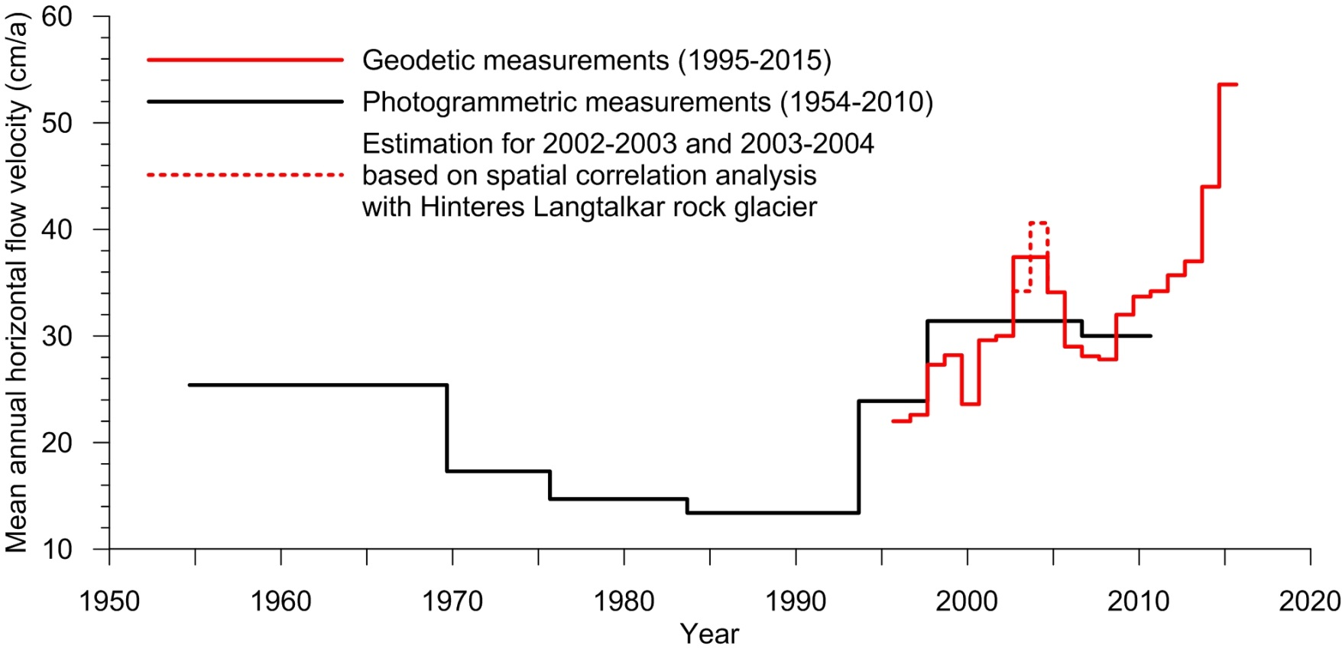
20 Years of Geodetic Monitoring of Dösen Rock Glacier (Ankogel Group, Austria) – A Short Review 5. Results
53.6 cm/a
28.1
25.4
13.4
Mean annual horizontal flow velocity of Dösen rock glacier for the time period 1995-2015. The velocities shown are mean values derived from 11 representative observations points (10-17, 21-23).

Slide 27
20 Years of Geodetic Monitoring of Dösen Rock Glacier (Ankogel Group, Austria) – A Short Review 6. Conclusions and Outlook
Mean annual flow velocity is a good indicator to describe rock glacier kinematics.
RTK-GNSS has proofed to be beneficial.
Accuracy obtained is sufficient. (Satellite availability will increase in the future: Galileo, Beidou, etc.)
Deformation analysis is possible.
Estimation of permafrost degradation (surface lowering due to ice melt) based on sparse point data is difficult. Annual rates computed are in the centimeter-level.
GPS/GNSS-equipped Wireless Sensor Network (WSN) for monitoring rock glacier kinematics: unattended operation, high spatial and temporal coverage and low cost (cp. Buchli et al. 2012)
To resolve intra-annual variations in rock glacier movement
To better support process understanding (influence of atmospheric warming, hydrology, etc.)

Slide 28
20 Years of Geodetic Monitoring of Dösen Rock Glacier (Ankogel Group, Austria) – A Short Review
For further information, please contact: Viktor Kaufmann Institute of Geodesy Working Group Remote Sensing and Photogrammetry Graz University of Technology Steyrergasse 30 A-8010 Graz, Austria E-mail: viktor.kaufmann@tugraz.at http://www.geoimaging.tugraz.at/viktor.kaufmann/

